Slide 1
Jaguar E-Type's 60th Anniversary a brief review of its pedigree 1948-1961
Martin Rowell
Steve Rohde

Slide 2
The Timeline

Slide 3
XK120: Jaguar's first sports car since1939
Manufactured between 1948 and 1954 : 12,045 were built, with over 80% exported .
At its Oct 1948 London Motor Show launch, the prototype had the new 3.4 ltr 6-Cyl XK engine , designed by Bill Heynes, Walter Hassan and Claude Bailey and was very competitively priced at £1300.
The "120" referred to the designed 120 mph top speed.
Intended for limited production, aluminium bodies were used until May 1950, the majority exported to US and Australia from the WW-2 Shadow Factory at Browns Lane , Allesley near Coventry .
In May 1949, 20 journalists were flown to Belgium to witness the Flying-Mile Record 132.6mph(213.4kph) on the Brussels-Ostend Motorway (Britain had no Motorways at that time).
XK 120's were available in three body styles:
An open 2-seater roadster (OTS)
A fixed head coupé (FHC) from 1951
A drophead coupé (DHC) from 1953

Slide 4
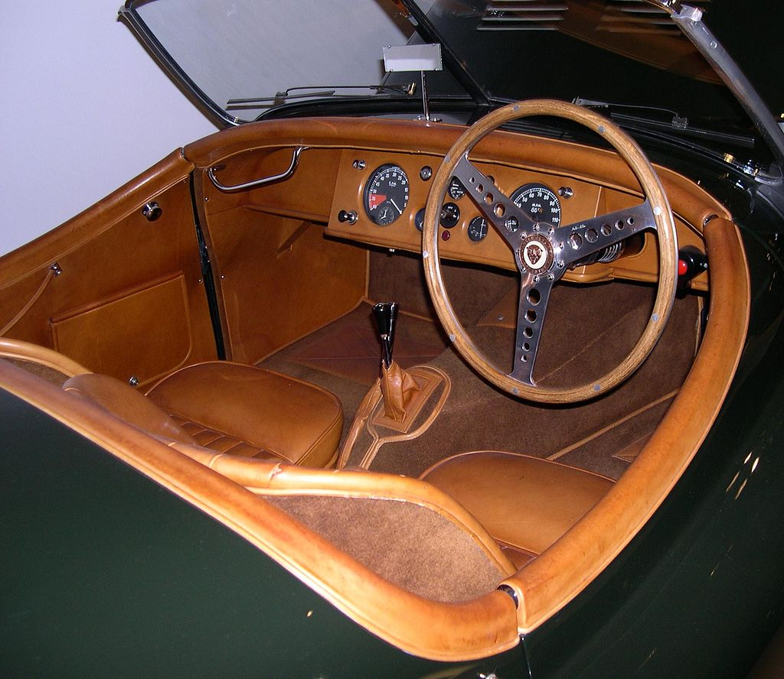
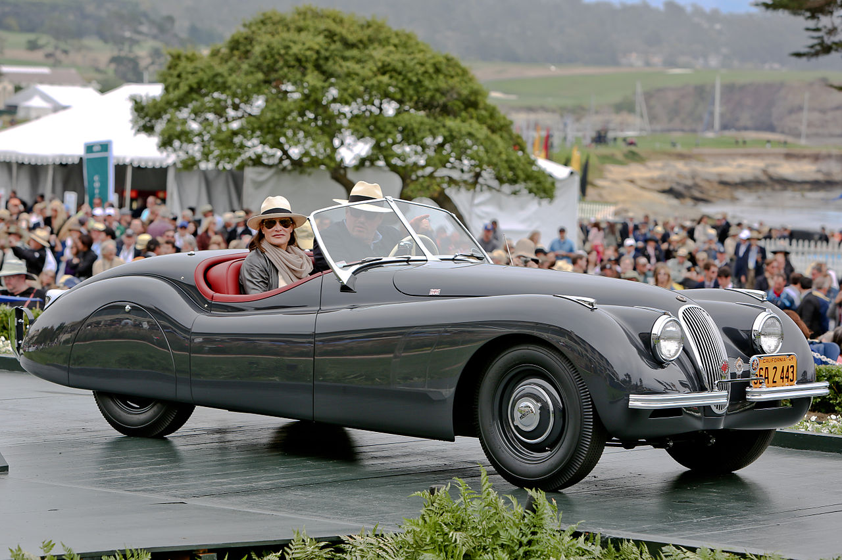
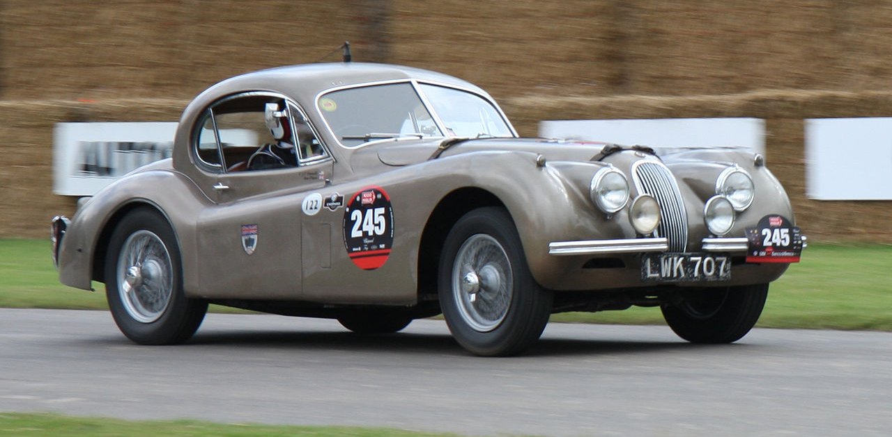
The Jaguar XK-120

Slide 5
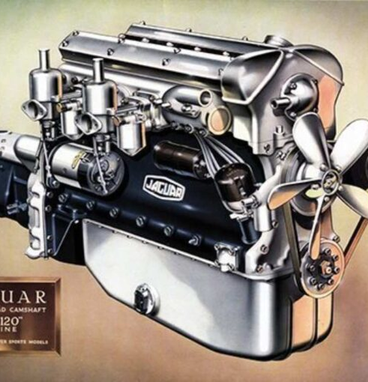
The classic 3.4 L straight-6 was highly advanced for a mass-produced unit of the time:
High-strength aluminium alloy cylinder head
Hemispherical combustion chambers
Inclined valves with bucket tappets
Twin side-draft SU carburetors
Dual chain-driven overhead-camshafts
160 hp with 8:1 compr. ratio & 80 octane fuel
Evolved to 3.8 & 4.2-litre versions.
The last 4.2L powered a Daimler DS420 in 1992

Slide 6
The XK 120 Won/Placed in Many Races
First victory: 1 & 2 at One-Hour Production Car Race Aug 1949 at Silverstone Circuit (only 1 hr from the Factory)
First US victory : Jan 1950 at Palm Beach Shores, Florida
Pebble Beach US : May 1950, XK120s finished 1 & 2
Tourist Trophy, Ireland: Sept 1950 in heavy rain, 21yr old Stirling Moss' stunning debut win in a 1–2–3 XK120 triumph
Alpine Rally: "NUB 120" FHC won Alpine Rally 1950, 51& 52
Australia: Feb 1954, won 24-hour Mt. Druitt Road Race
NASCAR Grand National: June 1954 , an XK120 was first imported car to win at Linden Airport, New Jersey. Foreign-made cars were banned from this series after this race.

Slide 7
Performance Tests & Speed Records
The UK Motor magazine tested a pre-production XK120 in Nov 1949 and reported:
A top speed of 124.6 mph
Acceleration 0–60 mph in 10.0 seconds
The car cost £1263 including taxes
1950: 24hrs at 107.5 mph (173.0 km/h, incl. fuel & tyre stops) at Montlhery Autodrome near Paris .
1951: One Hour at 131.8 mph (212.2 km/h) Montlhéry Autodrome.
1952: 7 Days&Nights, at 100.3 mph (161.4 km/h) again at Montlhéry
1953: Flying Mile at 172.4 mph (277.5 km/h) on Brussels Autobahn in bubble-top XK 120.

Slide 8
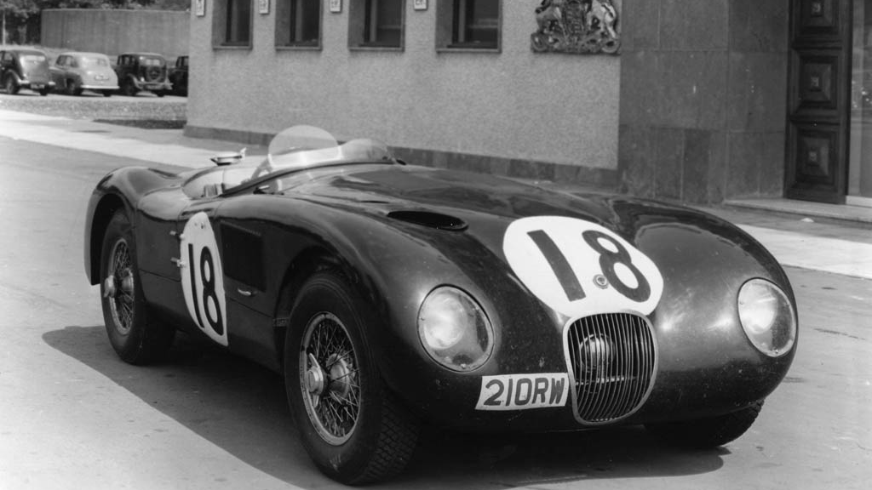
Jaguar C-Type (originally XK120-C)
Launched in 1950 , "C" stood for "competition"
A racing sports car produced from 1951 to 1953.
53 were built, 43 of which were sold to private owners, mainly in the US.
Developed under Chief Engineer Bill Heynes and built in Browns Lane Experimental Dept .
The C Type used proven running gear with a tubular space frame and new torsion bar-trailing arm Rear Axle .
Its aerodynamic aluminium body was specified by the famed ex-Aircraft Designer , Malcolm Sayer.
Originally tuned to 205 bhp with the classic 3.4L 6-Cyl .
1952 C-Types had SU carburetors and Alfin drum brakes .
In 1952, Moss & Chief-Tester Dewis did not finish a punishing Mille Miglia ,but Disc Brakes' superiority was conclusive .
1953 C-Types were:-
Lighter & more powerful
Used four wheel Dunlop disc brakes , which proved to be a Race-winning feature .
1951 LeMans 24hrs : of 3 C-Types one finished 1st .
1952 Le Mans : an unlucky race with all 3-cars overheating .
1953 Le Mans : crowning results, finishing 1, 2 & 3

Slide 9
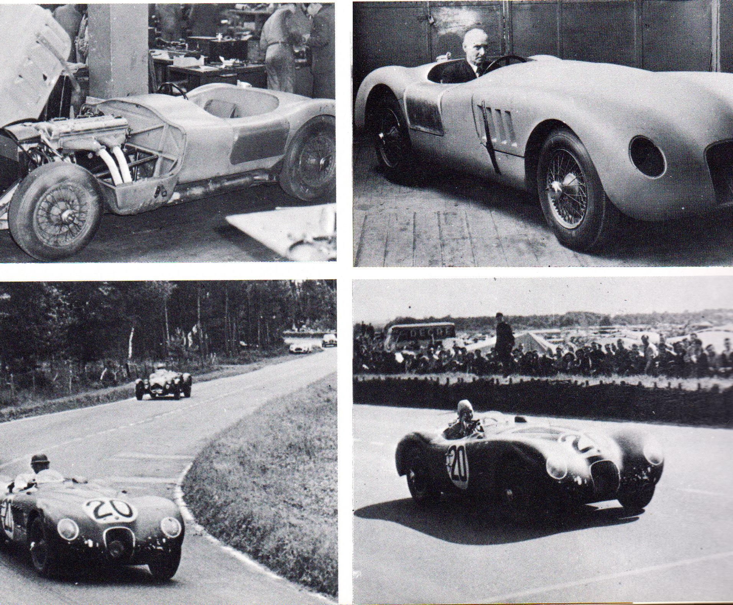
Jaguar C-Type

Slide 10
The C-D Prototype: Malcolm Sayer’s Aerodynamic Masterpiece
This one-off light-alloy hybrid went by several names, until C-D Prototype stuck .
First use of Malcolm Sayer's oval-cross-section "Monocoque Tub" with front Sub-Frame bolted to Firewall . 8 yrs later it would evolve into the E-Type .
First tests by Norman Dewis in May 1953 at Lindley Test track near Coventry .
Oct 1953, again on the Ostend Brussels Motorway, Dewis averaged 178.4 mph (287 km/h) over 1 mile .
Car had Perspex Cockpit Bubble

Slide 11
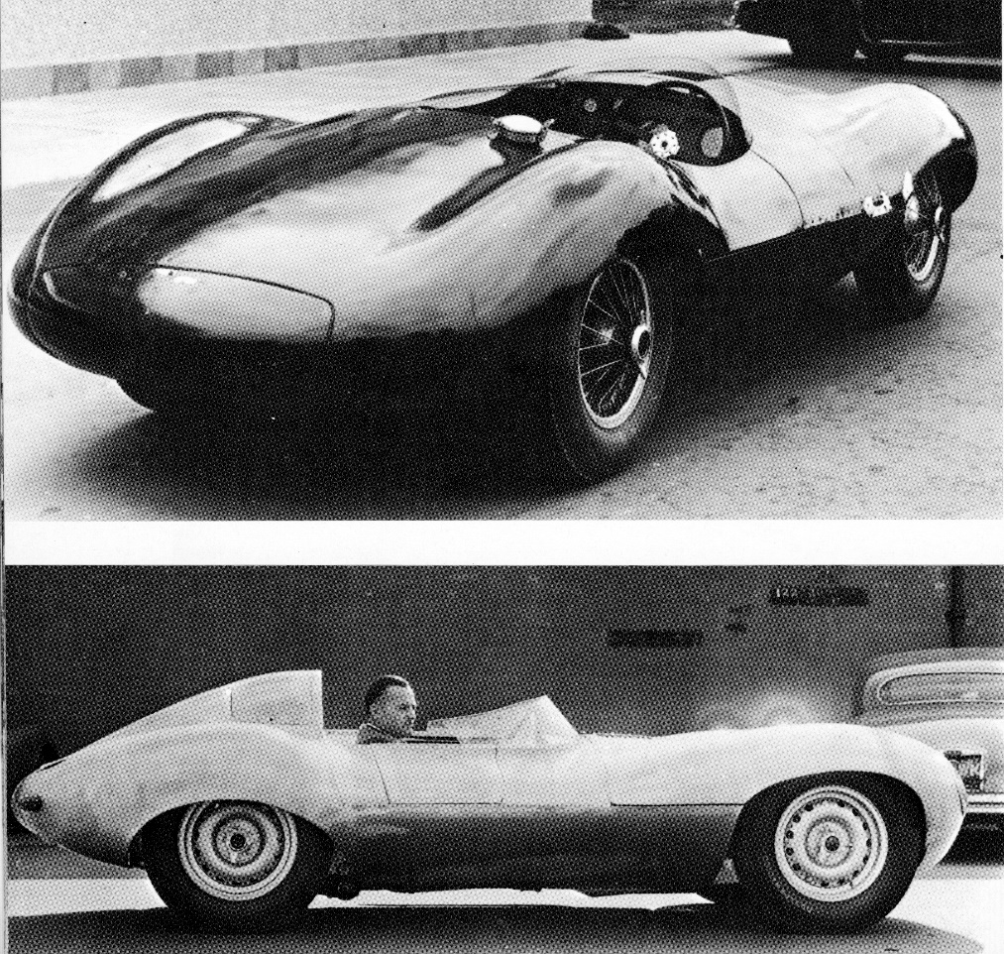
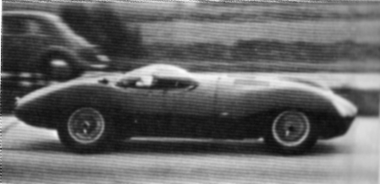
The Jaguar C-D Prototype

Slide 12
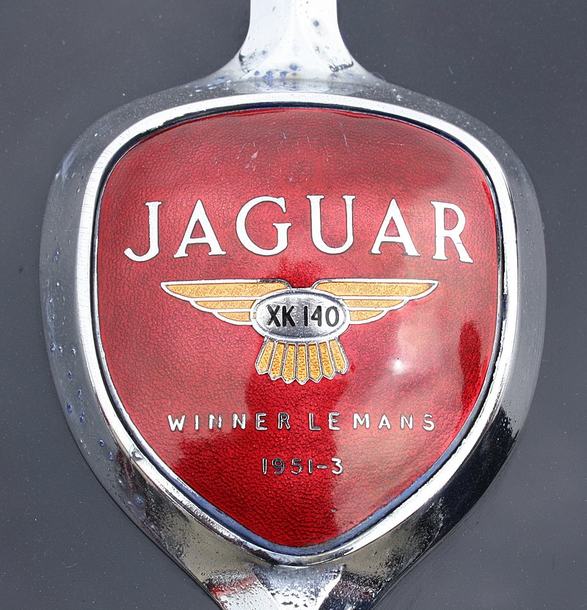
Jaguar XK140
Manufactured between 1954 and 1957 as XK120 successor
Introduced in late 1954 and sold as a 1955 model
Upgrades from the XK120 included:
More interior space for taller drivers by moving engine, firewall and dash forward to give 3 inches more legroom
4-speed Gearbox & Overdrive & Automatic optional
Improved drum brakes
Rack and pinion steering
Increased suspension travel
Telescopic shock absorbers
Exterior changes from XK120 included more substantial front and rear bumpers with overriders and flashing turn signals

Slide 13
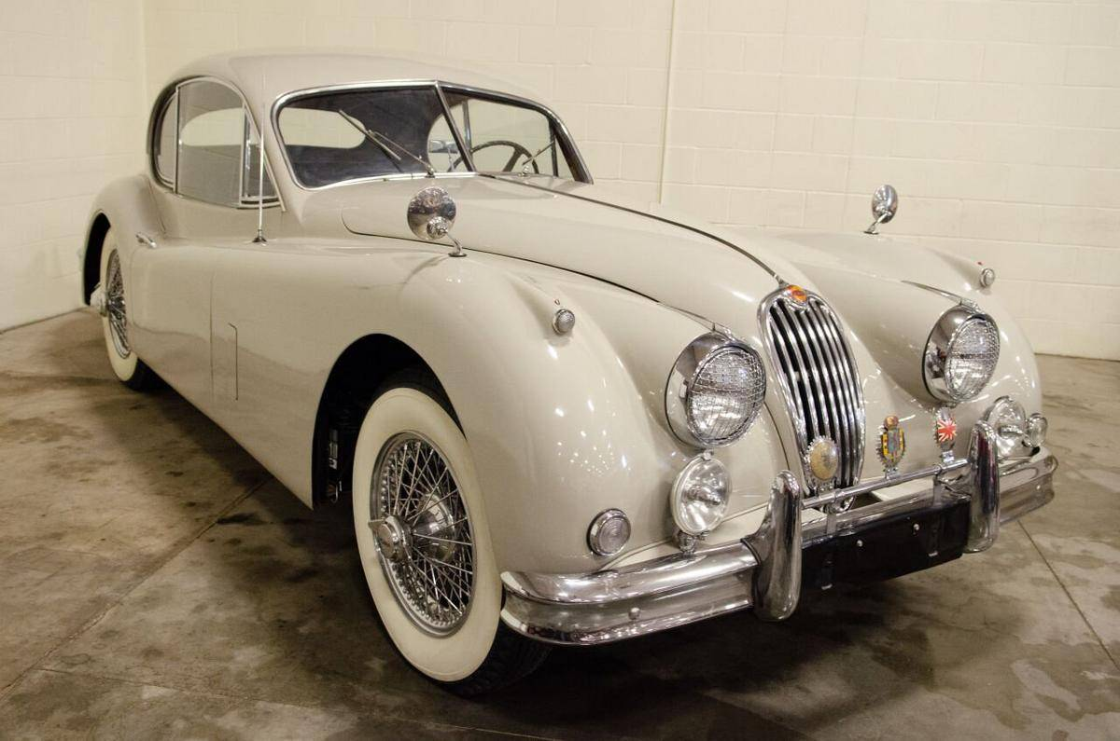
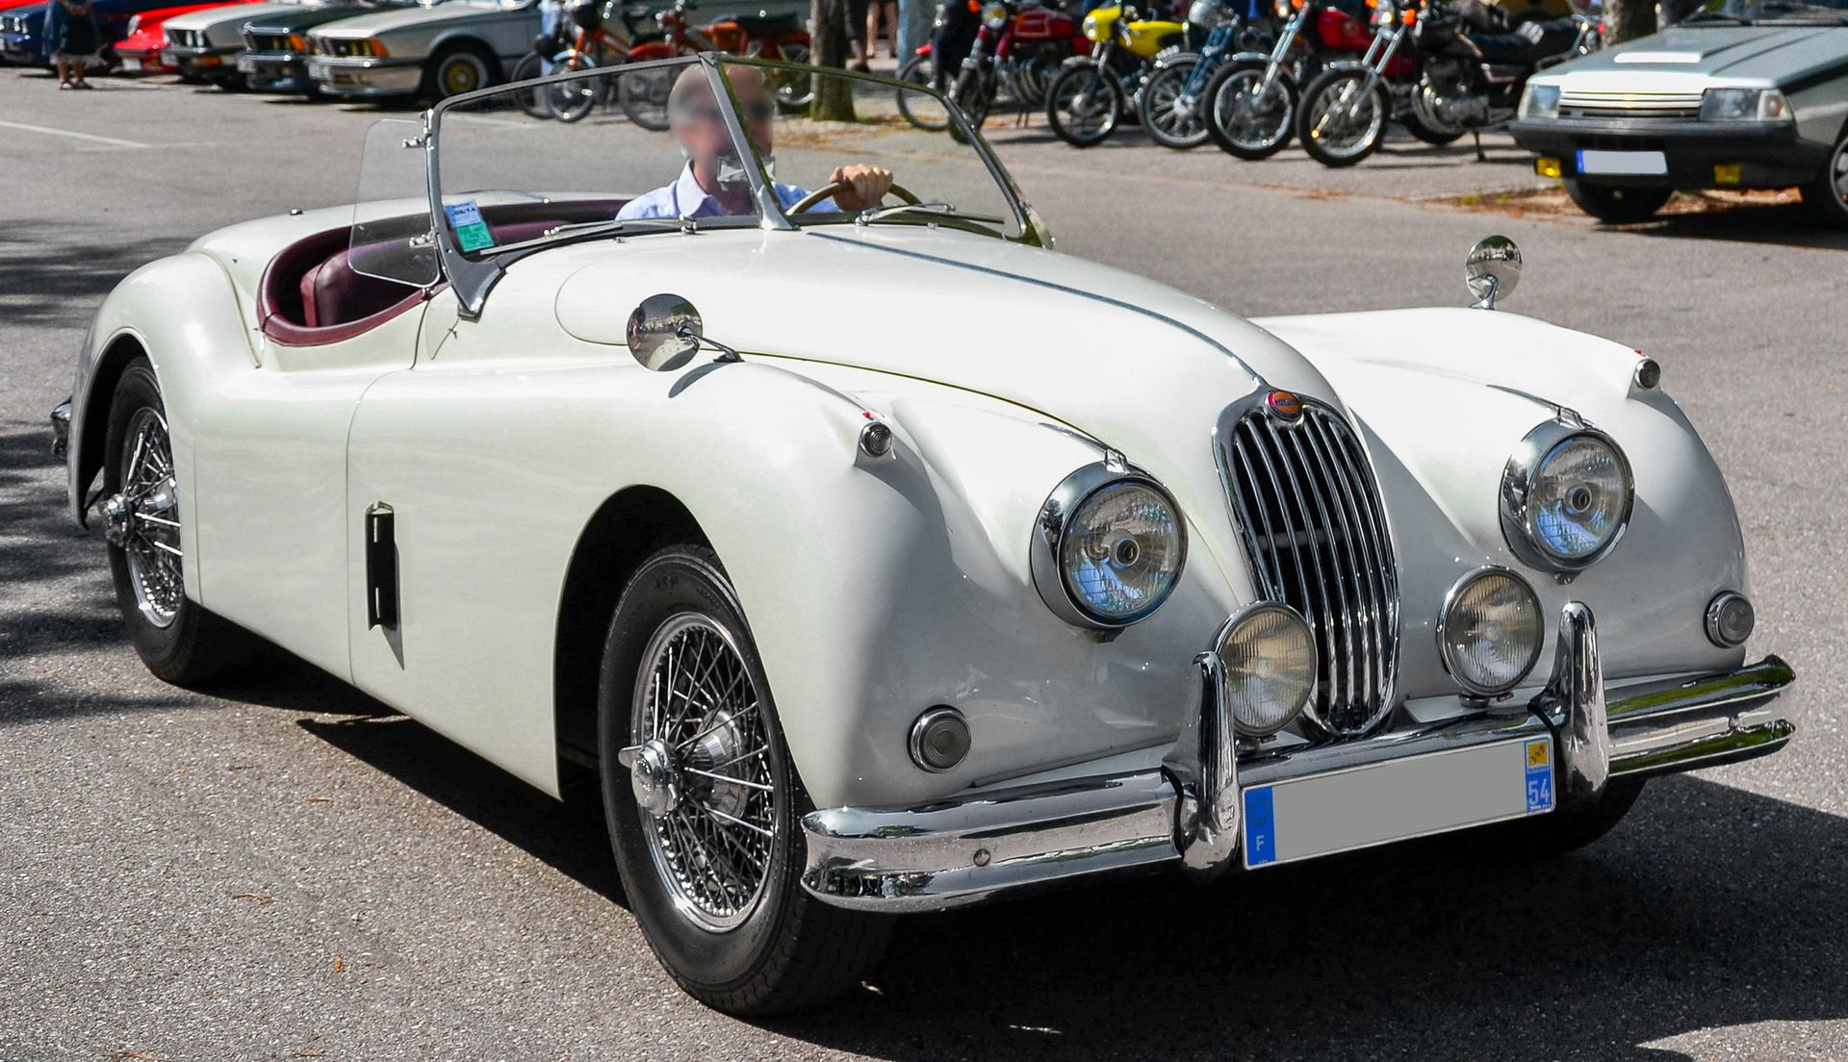
Jaguar XK-140 FHC & OTS

Slide 14
Powering the XK140
The XK140 retained 3.4 L straight-6 .
XK140 Special Equipment modifications raised power by 10 bhp to 190 bhp at 5500 rpm .
With optional C-Type cylinder-head from the XK120, power rose to 210 bhp at 5750 rpm
With C-type head, 2in SU- carburetors, heavier torsion bars and twin exhausts, the car was designated XK140 SE in UK and XK140 MC in USA.
In 1956 , the XK140 was first Jaguar sports car offered with Borg-Warner 3-Sp Automatic .

Slide 15
XK140 Engines
Model | Years | Displacement | Configuration | Bore/Stroke | Carburettor | Power
XK 140 3.4 | 1954-1957 | 3442 cc | DOHC Straight-6 | 83 mm x 106 mm | Double SU H6 | 190 bhp (142 kW; 193 PS) @ 5500 rpm
XK 140 3.4 SE (C-Type Head)("MC" in USA) | 1954-1957 | 3442 cc | DOHC Straight-6 | 83 mm x 106 mm | Double SU H6 | 210 bhp (157 kW; 213 PS) @ 5750 rpm

Slide 16
Performance Tests of the XK-140
A stock XK-140 SE could achieve a top speed of 120–125 mph .
Road & Track's XK-140 MC test June 1955 recorded two-way average 120.3 mph.
Acceleration 0–60 mph between 8.4 and 9.1 secs
Acceleration 0–100 mph in 26.5 secs
Standing 1/4 mile , 16.6 secs and 82 mph

Slide 17
The Jaguar XK150
XK150 was produced 1957 to 1961 as XK140 successor .
PRODUCTION: 6,645 had 3.4 L & 1284 had 3.8L (1492 Automatic G-box)
Initially available as fixed head coupé (FHC) and drophead coupé (DHC)
XK 150-S Roadster launched in 1958 .
PRODUCTION: 1,911 had 3.4 L & 275 had 3,8L (all 4-speed with Overdrive) .
Minimal rear seats available in the FHC coupés
Windshield semi-wraparound : first time , wind-up windows .

Slide 18
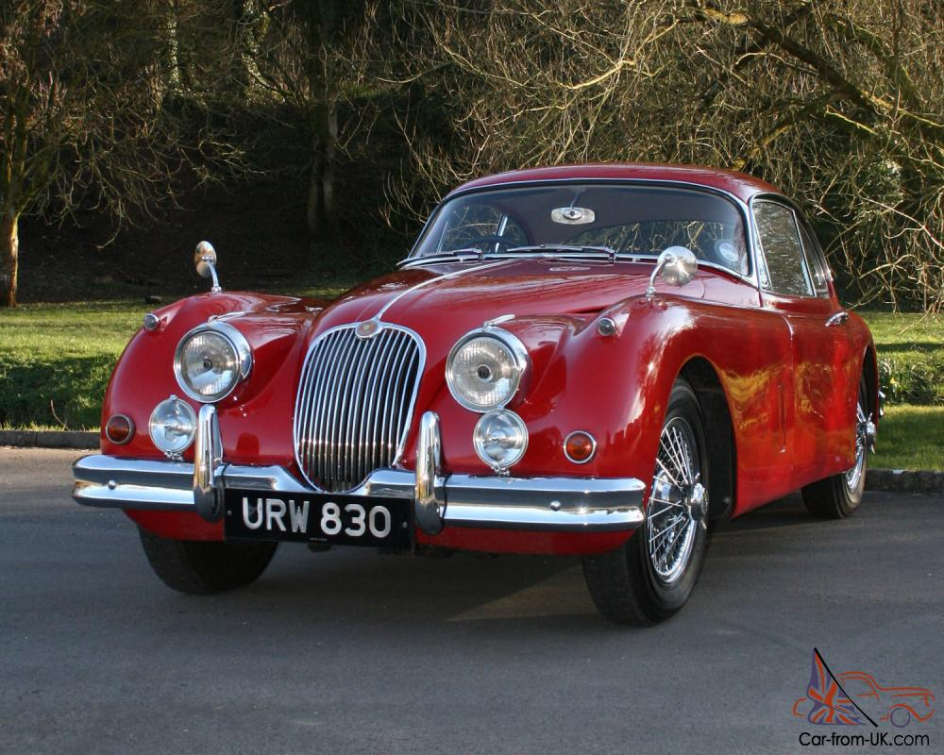
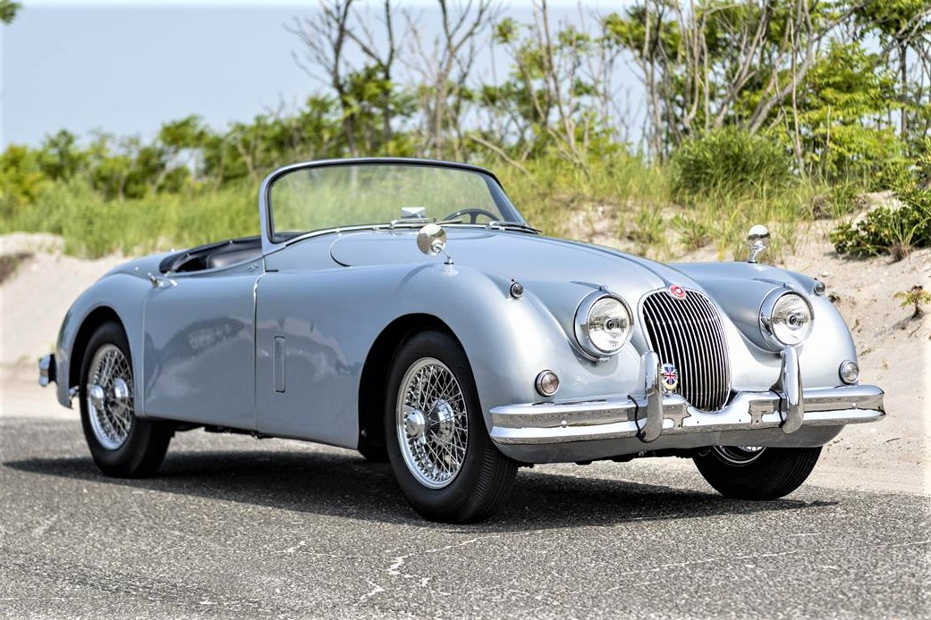
The Jaguar XK-150

Slide 19
Jaguar XK150 Engines
In Spring 1958 , Initial XK150 engine & braking issues were corrected with Special Equipment SE engine & 4-wheel disc brakes .
The 3.4 L Straight -6 engine had:
Two 1.75-inch SU-HD6 carburettors.
A B-type cylinder head with larger exhaust valves.
Power : 210 bhp at 5500 rpm
XK 150-S had three 2-inch SU -HD8 carburetors and a straight-port cylinder head, boosting power to 250 bhp at 5750 rpm.
In 1960 the 220 bhp 3.8 L (from Mark IX Sedan) gave 265 bhp.
Speed 135 mph (217 km/h) : 0–60 mph in 7.0 secs : 18mpg

Slide 20
XK150 Engines
XK 150 ENGINES ^{[10][11]}
Model | Years | Displacement | Configuration | Bore/Stroke | Carburettor | Power
XK 150 3.4 | 1957–1960 | 3442cc | DOHC Straight-6 | 83 mm x 106 mm | Double SU HD6 | 190 bhp (142 kW; 193 PS) @ 5500 rpm
XK 150 3.4 SE | 1957–1960 | 3442cc | DOHC Straight-6 | 83 mm x 106 mm | Double SU HD6 | 210 bhp (157 kW; 213 PS) @ 5500 rpm
XK 150 3.4 S | 1958–1960 | 3442 cc | DOHC Straight-6 | 83 mm x 106 mm | Triple SU HD8 | 250 bhp (186 kW; 253 PS) @ 5500 rpm
XK 150 3.8 SE | 1959–1960 | 3781 cc | DOHC Straight-6 | 87 mm x 106 mm | Double SU HD6 | 220 bhp (164 kW; 223 PS) @ 5500 rpm
XK 150 3.8 S | 1959–1960 | 3781 cc | DOHC Straight-6 | 87 mm x 106 mm | Triple SU HD8 | 265 bhp (198 kW; 269 PS) @ 5500 rpm

Slide 21
Performance
The Motor in 1959 tested a 250 bhp 3.4 litre XK150S fixed-head coupé with limited-slip differential.
Top speed 132 mph
Acceleration: 0–60 mph in 7.8 secs
Fuel consumption: 18.3 mpg
Cost: £2110 including taxes of £62
At the time, this was the fastest closed car the UK magazine had ever subjected to a road test.

Slide 22
Jaguar XK150 By Bertone
In 1958 3 bare chassis were shipped to Carrosseria Bertone in Turin to receive special bodies as prototype fixed-head coupés.
They were reportedly meant to be the replacement for the XK150 and had an "XKE" badge on their rear flanks --- a taste of things to come .
This XK 150 Special would be the precursor of the E-Type

Slide 23
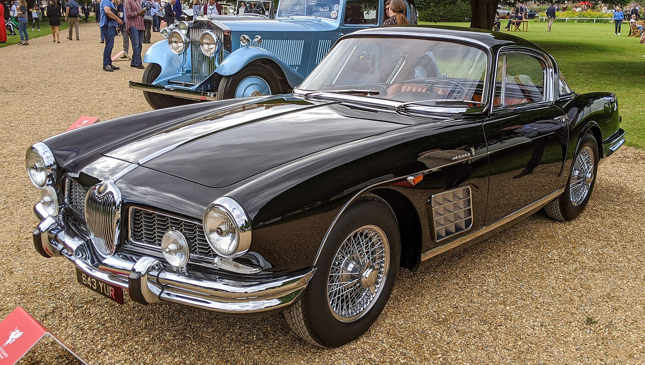
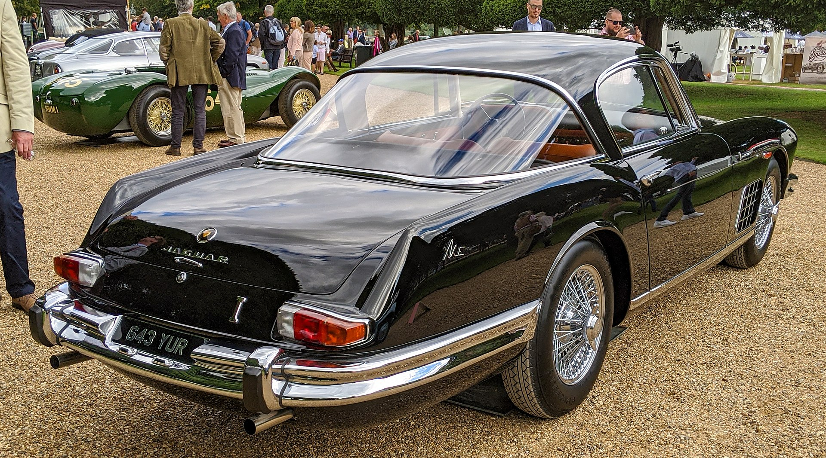
1958 Jaguar XK-150S Bertone

Slide 24
Original XKC 401 : Named D-Type June 54 at Le Mans
The Jaguar D-Type was a sports racing car produced between 1954 and 1957
Designed to win LeMans 24hr Race, it succeeded spectacularly for three consecutive years from 1955
Apr 1954, Dewis first tested the first D-Type (originally named XKC 401) Short Nose
May 1954 Le Mans Practice, Dewis drove 169 mph on Mulsanne Straight and lapped at 115 mph
It shared the straight-6 3.4 L Engine-Gearbox and some components with its C-Type predecessor
The oval cross-section body , with a one-piece tilting front structure ,reduced frontal area and was designed by Aerodynamicist Malcolm Sayer
1955 & 56 Race Rules change : Long-Nose bonnets and with full width wind-screens
Engine and Front Suspension carried by a tubular Subframe bolted to the Monocoque "Tub" at the firewall
Engine mounted lower thanks to Dry-Sump Lubrication and tilted 8 degrees
245bhp at 5750rpm
3 x Twin Choke Weber Carburetors took fuel from two flexible fuel tanks (37 gals)
SU and Lucas developed Fuel Injection options
New 4-speed Synchromesh Gear Box and Triple Plate Clutch
A distinctive vertical Tail Fin merged with the low wrap-round wind screen
A so-called passenger "seat" accessed via a removable panel: With twin side-exhausts below a true Hot Seat
Weighed only 2900 pounds

Slide 25
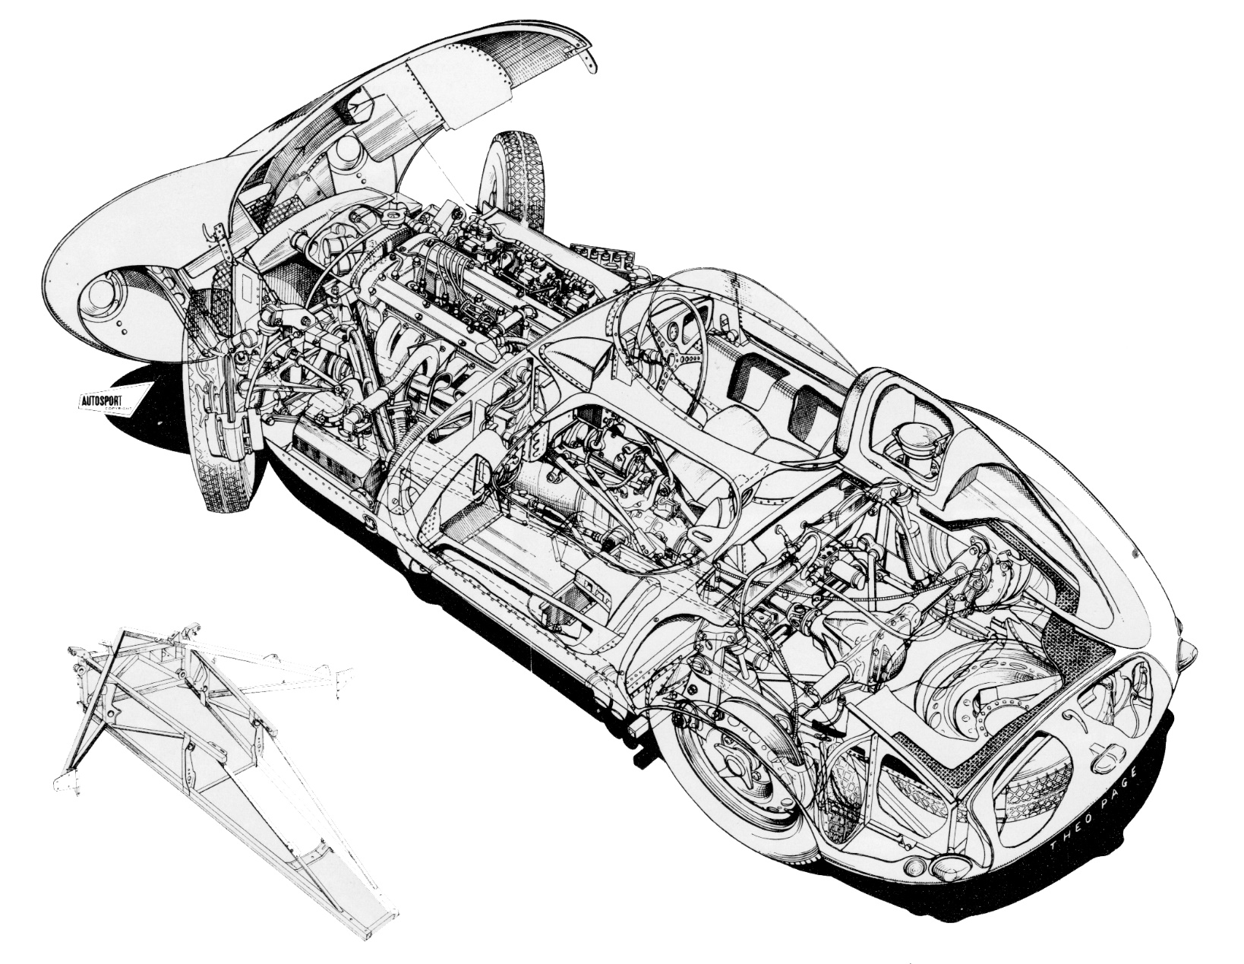
Cutaway Drawing D-Type

Slide 26
Short & Long Nose D-Types : 1954-57

Slide 27
D-Type Racing Successes
D-Type Production : 71 built (plus 16 XK-SS )
1954 Le Mans 24hrs: 3 ran, 1 finished 2nd : 105 secs behind Ferrari !
Fastest at 172 .8 mph on Mulsanne Straight
1954 Rheims 12 hrs : 3 ran , 2 finished 1st & 2nd
1955 Le Mans 24 hrs : 3 ran + 2 Private cars : 2 finished 1st & 3rd. Victory marred by 80 deaths in multi-car accident
1956 Le Mans 24hrs: 3 Factory & 3 Private cars : 2 finished 1st & 4th
End 1956 Factory Race Team disbanded : 2 cars sold to Ecurie Ecosse
Jan 1957 D-Type-based XK - SS production start
Feb 12-1957 Factory Fire : production resumed in 2 days!
1957 Le Mans 24 hrs : Four Teams ran 5 cars : Five finished 1-2-3-4-6

Slide 28
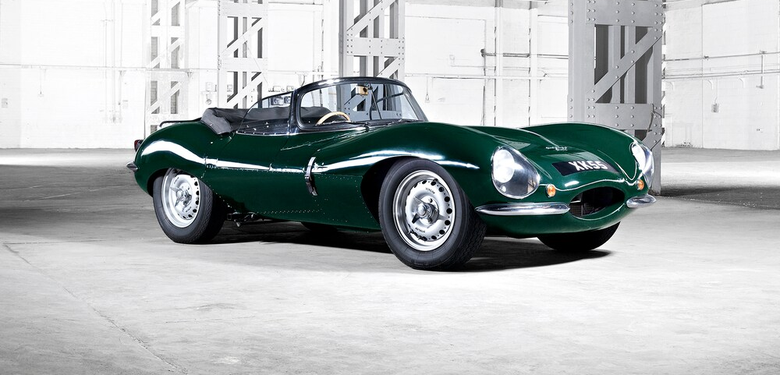
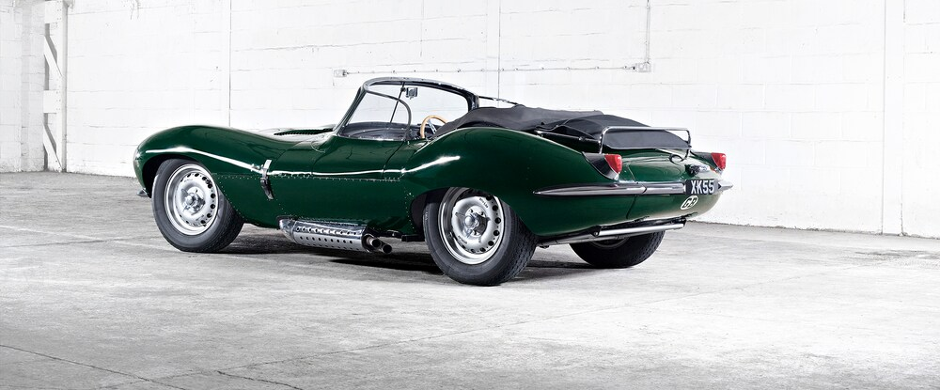
1957 Jaguar XK SS: 16 Survived Fire

Slide 29
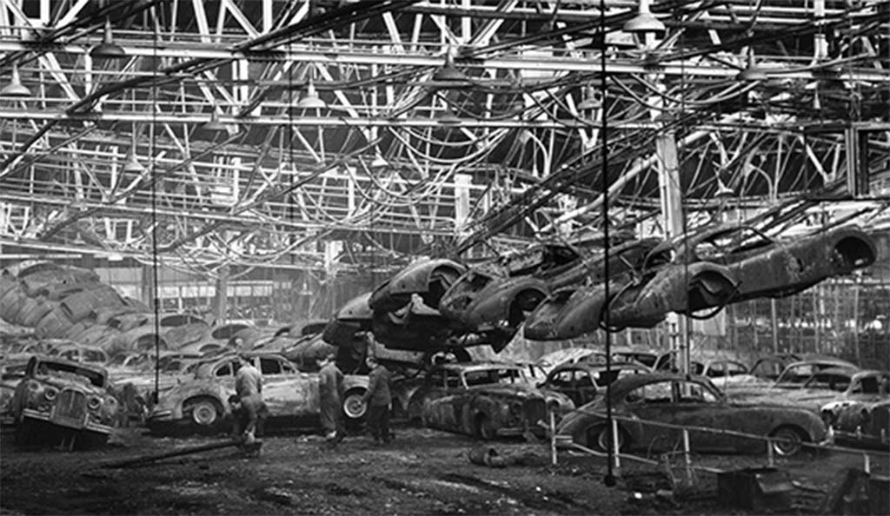
Feb 12 , 1957 Jaguar Factory Fire

Slide 30
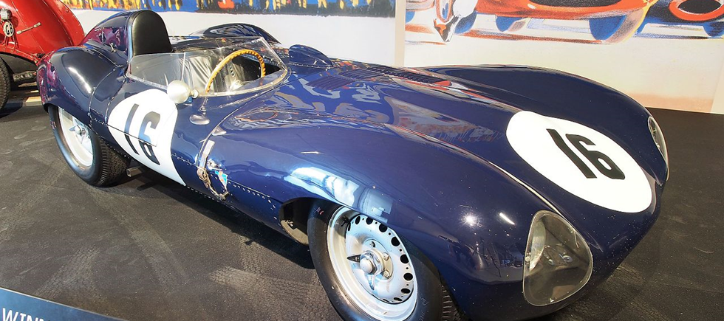
The Jaguar D Type

Slide 31
Evolution
D-Type -->
E-Type
1957 : Body E1A : D-Type-based Alum.Alloy prototype, initially with 2.4L 4-Cyl and Independent Rear Suspension (IRS) .
After testing, decision to use 3.4 & 3.8L Engines (E1A scrapped end-59).
1958 LeMans Rules change to max 3.0L.
1959-60: Body E2A with 3L engine : performance issues solved by 3.8 L engine: US Importer Cunningham ran car at Le Mans.
1961: E2A "rescued'' by Woodley & Griffiths Families for their Museum collection.
2008: E2A sold to Swiss owner, who ran it at 50th Anniv. Le Mans in 2010 .

Slide 32
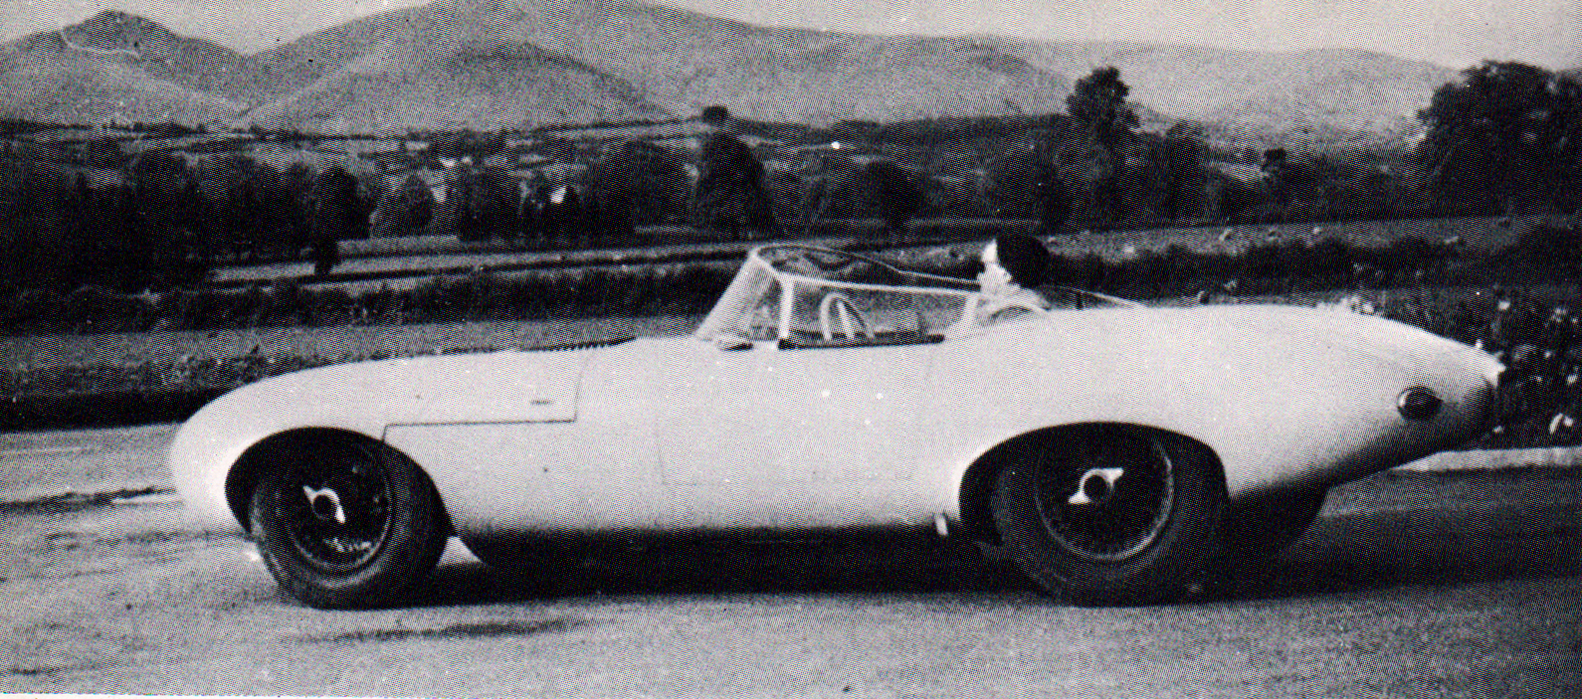
1957 E1A (Aluminium) Prototype

Slide 33
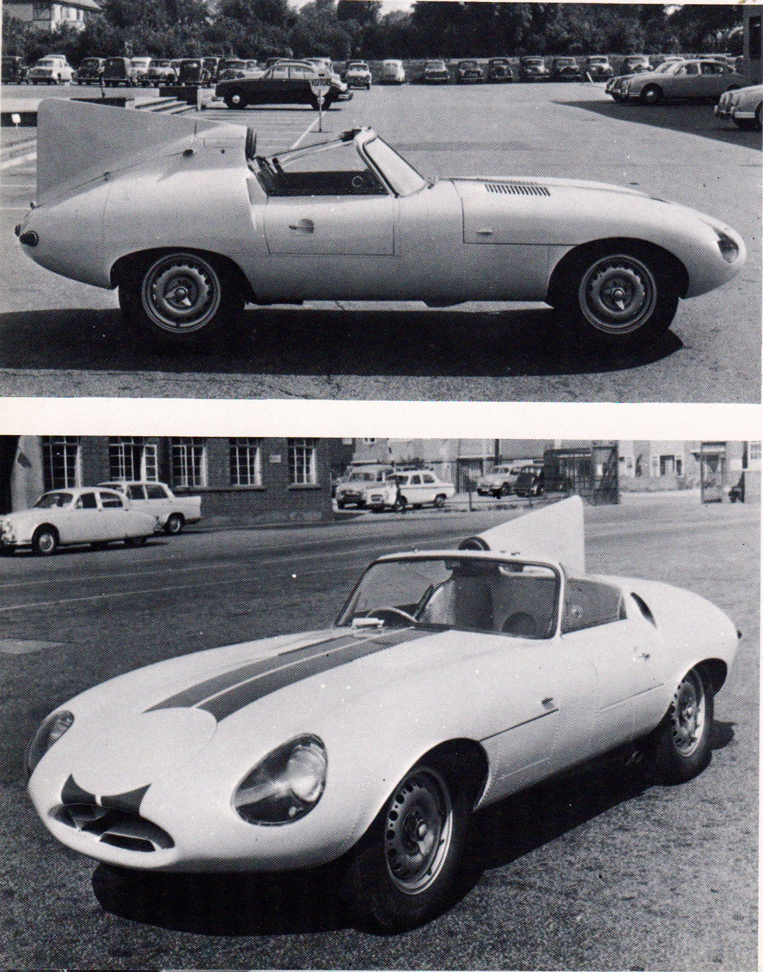
Cunningham's 1959 E2A Prototype

Slide 34
The Iconic E -Type & successors : launch & production.
17 March 1961: Festive Global launch at Geneva Motor Show by Sir William Lyons : overflow of journalists clamour for expanded Road Test-days .
The night after UK Press unveiling, PR-Boss Bob Berry, drove 9600HP (Metallic Grey FHC, nr 2 ) 700miles in 11 hrs (no motorways!) to to arrive in time for the Geneva Press Luncheon !
18 March : global press interest was such, that Norman Dewis was ordered to drive 77RW (Dark Green OTS) overnight from Coventry, to allow test drives with both cars over several days .
1961-64: built 15,490 with 3.8L
1965-68: built 17,320 with 4.2L
1966-68: Series 1- 2+2 Coupe : Geneva Show launch : 5,600 built with 4.2L
1968-69: Series 2: 13,490 built with 4,2L
1969-70: Series 2- 2+2 Coupe : 5,330 built with 4.2L
1971-75: Series 3: built 7,300 with 5.3L V12
Ultimately, 72,520 E-Types Series would be built between 1961 and 1975 .
Its combination of striking beauty, performance and pricing established the model as an permanent icon of the motoring world with 150 mph top speed and sub-7-sec 0 to 60 mph acceleration.
Its monocoque + subframe construction, disc brakes and independent rear-suspension distinguished the car and spurred industry-wide changes.

Slide 35
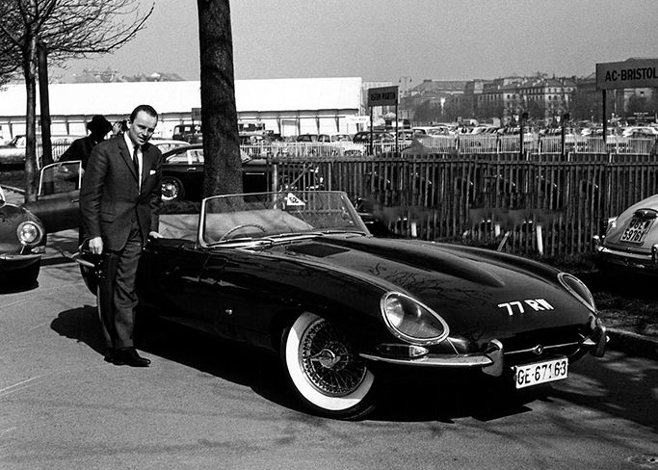
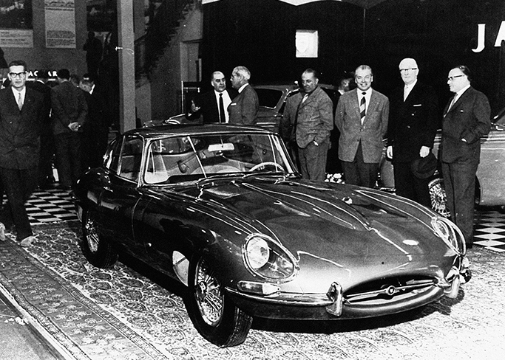
Jaguar E Introduction at 1961 Geneva Show

Slide 36
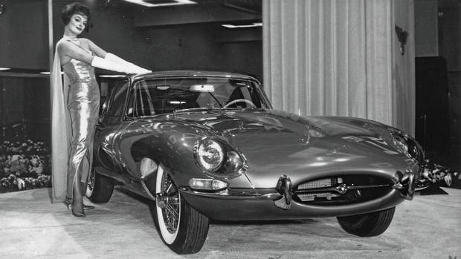
In 1961 the Jaguar E-Type made its North American debut at the New York International Auto Show
Attracted record-breaking crowds, with 47,000 people squeezing on to the Jaguar stand on Day One alone, completely stealing the show!
A gold E-Type coupe was joined on the turntable by Playboy model, Marilyn Hanold, dressed in a shimmering gown, white gloves and floor-length silk scarf

Slide 37
Evolution of the E-Type Jaguar
The E-Type was introduced in 1961 as:
Grand tourer coupé and a two-seater convertible "roadster"
A "2+2" four-seat version of the coupé, with longer wheelbase, was released in 1966
Model updates were designated "Series 2" and "Series 3" : over time, the earlier cars are now referred to as "Series 1
Series 1 cars fell into two categories:
Those between 1961-1964 had 3.8 L engines
Those between 1965-1967 had 4.2 L engines
The 4.2L produced same 265 bhp as 3.8L, same 150mph but Torque rose from 260- 283 lb.ft

Slide 38
Summary
Among classic post WW2 automobiles, the E-Type remains enthusiasts' and the public's favourite .
Jaguar founder William Lyons's eye-for-style was evident from the outset in 1920's : a series of performance cars in 1930's set the stage for the spectacular 1949 unveiling of XK 120 at London & NewYork Motor Shows.
E-Type's predecessors, C- & D-Type Race Cars, were descendants of XK120 (48-53) & XK140 (1954-57).
Starting in1950 "racing promoted sales" : C-Types won many events including Le Mans 1951 and 53.
From late- 53 to mid-54, the "C-D Prototype" was precursor to D- & E-Type (achieving 178 mph in Oct 53)
After D-Types won LeMans 1955, 56 & 57, private teams took over racing, with factory support.
In 1957, D-Type-based "E1A Prototype" featured the 1961 E-Type's main design elements.
Presented at 1961 Geneva Show, the E-Type's styling,150mph and competitive pricing, were top features.
In 1960 "E2A Prototype" loaned to US Importer Cunningham, ran at Le Mans 50th Anniversary in 2010 .
Happily, these and other rare Jaguars can be admired at various international museums and events.

Slide 39
E-Type Series 1 Road Tests
Motor Magazine: "The new 4.2 supersedes the early 3.8 as the fastest car Motor has tested. The absurd ease which 100 mph (161 km/h) can be exceeded in a ¹⁄₄ mile (402 m) never failed to astonish. 3,000 miles of testing confirms that this is still one of the worlds outstanding cars"
Autocar: it as "In its 4.2 guise the E-Type is a fast car (the fastest we have ever tested) and offers just about the easiest way to travel quickly by road."

Slide 40
XK-E Initial Engines
The 4.2-litre engine produced the same power as the 3.8-litre (265 bhp;198 kW) and same top speed (150 mph;241 km/h)
Torque was increased approximately from 240 to 283 lb⋅ft
Acceleration remained pretty much the same and 0 to 60 mph times were around 6.4 seconds
Maximum power was now reached at 5,400 rpm instead of 5,500 rpm on the 3.8-litre
That all meant better throttle response for drivers that did not want to shift down gears
The 4.2-litre's block was completely redesigned, made longer to accommodate 5 mm (0.20 in) larger bores, and the crankshaft modified to use newer bearings.
Other engine upgrades included a new alternator/generator and an electric cooling fan for the radiator

Slide 41
Jaguar XK-E Series 2 Changes
The most distinctive exterior feature was the absence of the glass headlight covers
Series 2 cars had a wrap-around rear bumper, larger front indicators and tail lights re-positioned below the bumpers, and an enlarged grille and twin electric fans to aid cooling
They also had:
A steering lock which moved the ignition switch to the steering column, replacing the dashboard mounted ignition and push button starter
The symmetrical array of metal toggle switches were replaced with plastic rockers
A collapsible steering column to absorb impact in the event of an accident
New seats allowed the fitment of head restraints, as required by U.S. law beginning in 1969
The engine is easily identified visually by the change from smooth polished cam covers to a more industrial "ribbed" appearance
The engine was de-tuned in the US with twin two-barrel Strombergs replacing three SUs. Reducing horsepower from 265 to 246 and torque from 283 to 263
Air conditioning and power steering were available as factory options

Slide 42
Jaguar XK-E Series 2 Series 2 (1968–71)
Overview
Also called | Jaguar XK-E^{[50]}
Production | 1968–71^{[31][32]}
Body and chassis
Body style | 2-door fastback coupé 2-door 2+2 fastback coupé 2-door roadster
Powertrain
Engine | 4.2 L XK I6
Dimensions
Kerb weight | 3,018 lb (1,369 kg) (FHC) 2,750 lb (1,247 kg) (OTS) 3,090 lb (1,402 kg) (2+2)^{[34]}

Slide 43
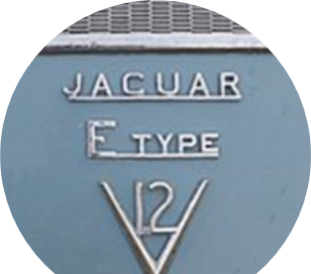
Jaguar XK-E Series 3 Changes
The E-Type Series 3 was introduced in 1971
It had a new 5.3 L Jaguar V12 engine, uprated brakes and standard power steering.
The V12 was equipped with four Zenith carburetors
It produced a claimed 203 kW (272 hp), more torque, and a 0-60 mph acceleration of less than seven seconds
The short wheelbase FHC body style was discontinued, with the Series 3 available only as a convertible and 2+2 coupé.
The final production E-Type OTS Roadster was built in June 1974]
Optionally an automatic transmission, wire wheels and air conditioning were available.
The Series 3 is easily identifiable by the large cross-slatted front grille, flared wheel arches, wider tires, four exhaust tips and a badge on the rear that proclaims it to be a V12

Slide 44
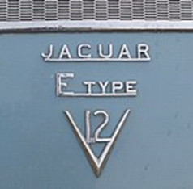
Jaguar XK-E Series 3 Changes, ct’d.
The newly used longer wheelbase offered significantly more room in all directions
Easily identifiable by the large cross-slatted front grille, flared wheel arches, wider tires, four exhaust tips and a badge on the rear that proclaims it to be a V12
The first published road test of the series 3 was in Jaguar Driver, the club magazine of the Jaguar Drivers' Club
Cars for the US market were fitted with large projecting rubber bumper over-riders (in 1973 these were on front, in 1974 both front and rear) to meet local 5 mph impact regulations,
US models also had side indicator repeats on the front wings.
There was a very limited number of six-cylinder Series 3 E-Types built.
The V12 Open Two Seater and V12 2+2 were factory fitted with Dunlop E70VR − 15-inch tires on 15 × 6K wire or solid wheels

Slide 45
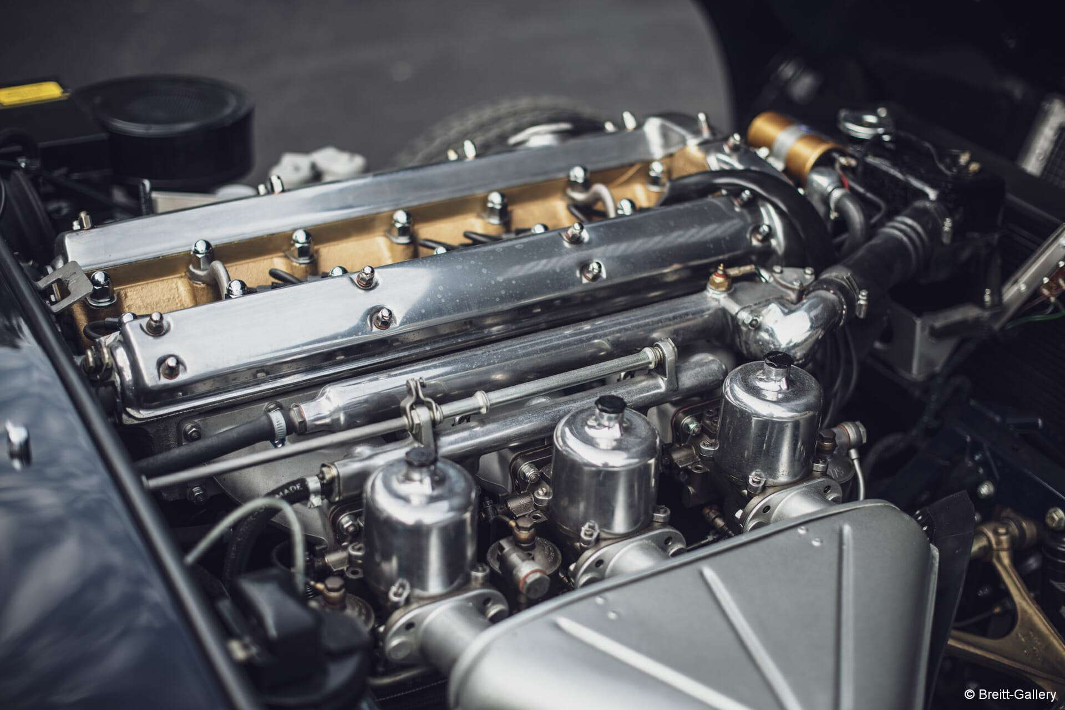
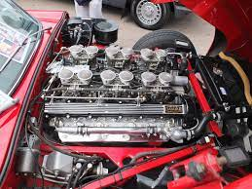
Jaguar XK-E Engines
Inline-6
V12

Slide 46
Motorsports
The 1963 Australian GT Championship was won by a "lightweight" E-Type
The Jaguar E-Type was very successful in SCCA Production sports car racing with Group 44 taking the B-Production championship with a Series-3 V12 racer in 1975
A few years later aGran-Turismo Jaguar from Cleveland Ohio campaigned a 4.2-litre six-cylinder FHC racer in SCCA production series, and in 1980 won the National Championship in the SCCA C-Production Class, defeating a fully funded factory Nissan Z-car team with Paul Newman

