Slide 1
60th Anniversary of the E-Type A Brief History of Jaguar Sports Cars
Martin Rowell
Steve Rohde

Slide 2
The Timeline

Slide 3
XK120: Jaguar's first sports car since1939
Manufactured between 1948 and 1954 : 12,045 were built, with over 80% exported .
At its Oct1948 London Motor Show launch, the single prototype had a new 3.4 ltr 6-Cyl XK engine : designed by Bill Heynes, Walter Hassan and Claude Bailey, its price was Pd1300.
The "120" in the name referred to the designed 120 mph top speed.
Intended for limited production, aluminium bodies were used until May1950, the majority exported to US and Australia from the WW-2 Shadow Factory in Allesley near Coventry .
In May 1949, 20 journalists were flown to Belgium see an new Flying-Mile Record 132.6mph(213.4kph) on the Brussels-Ostend Motorway (Britain had no Motorways at that time).
XK 120's were ultimately available in three body styles:
An open 2-seater roadster (OTS)
A fixed head coupé (FHC) from 1951
A drophead coupé (DHC) from 1953

Slide 4
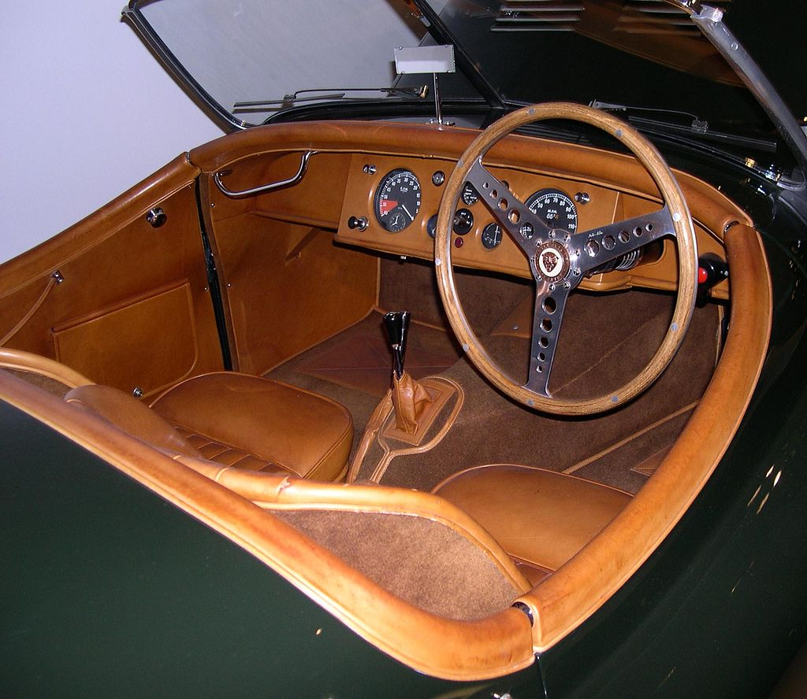
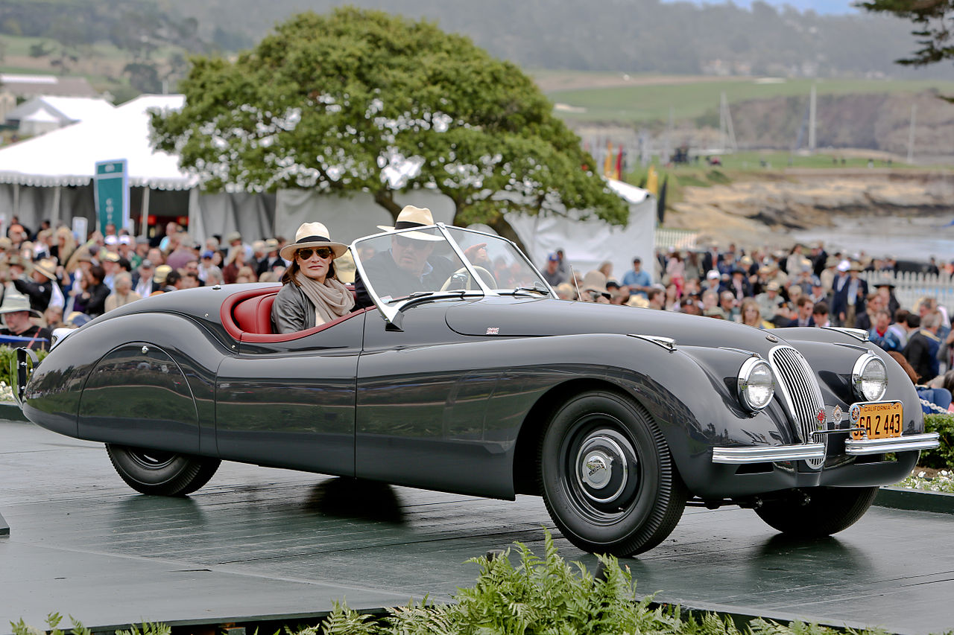
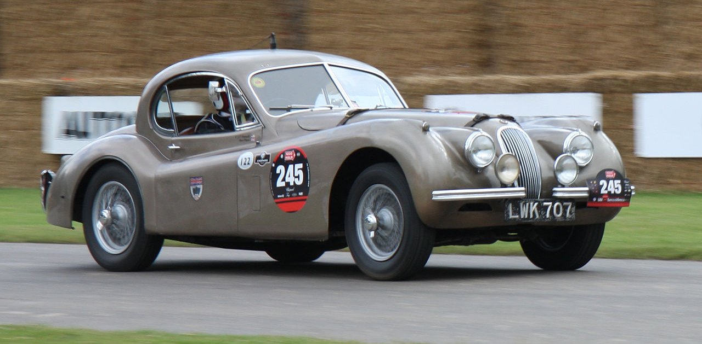
The Jaguar XK-120

Slide 5
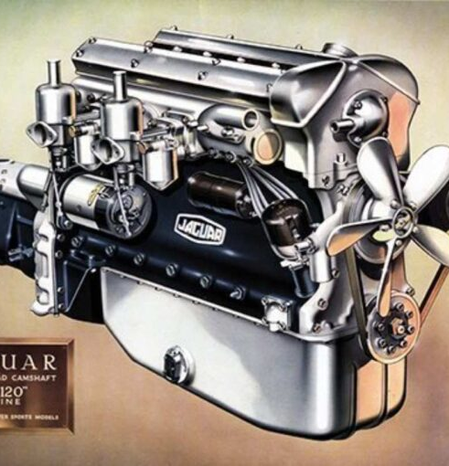
The classic 3.4 L straight-6 was highly advanced for a mass-produced unit of the time:
High-strength aluminium alloy cylinder head
Hemispherical combustion chambers
Inclined valves with bucket tappets
Twin side-draft SU carburetors
Dual chain-driven overhead-camshafts
160 hp with 8:1 compr. ratio & 80 octane fuel
Evolved to 3.8 & 4.2-litre versions until 1974

Slide 6
The XK 120 Won/Placed in Many Races
First victory: 1 & 2 at One-Hour Production Car Race Aug 1949 at Silverstone Circuit (conveniently 1 hr from the Factory)
First US victory : Jan 1950 at Palm Beach Shores, Florida
Pebble Beach US : May 1950, XK120s finished 1 & 2
Tourist Trophy, Ireland: Sept 1950 in heavy rain, 21yr old Stirling Moss' stunning debut win in a 1–2–3 XK120 triumph
Alpine Rally: "NUB 120", won the Alpine Rally 1950, 51& 52
Australia: Feb 1954, XK120 won 24-hour Mt. Druitt Road Race
NASCAR Grand National: June 1954 , an XK120 was first imported car to win at Linden Airpor, New Jersey. Foreign-made cars were banned from this series after this race.

Slide 7
Performance Tests & Speed Records
The UK Motor magazine tested a pre-production XK120 in Nov 1949 and reported:
A top speed of 124.6 mph
Acceleration from 0–60 mph in 10.0 seconds
The car as tested cost £1263 including taxes
1950: 107.5 mph (173.0 km/h) for 24 hours (including stops for fuel & tyres) at the Montlhery Autodrome near Paris .
1951: 131.8 mph (212.2 km/h) One Hour Record at Montlhéry
1952: 100.3 mph (161.4 km/h) for 7 Days &Nights, again at Montlhéry
1953: 172.4 mph (277.5 km/h) Flying Mile on Brussels Autobahn in bubble-top XK 120.

Slide 8
XK 120 Production Numbers 1948-54
 | Right-hand | Left-hand | Total
Open two-seater | 1170 | 6436 | 7606
Fixed-head | 195 | 2477 | 2672
Drop-head | 295 | 1472 | 1767
Total | 1660 | 10385 | 12045

Slide 9
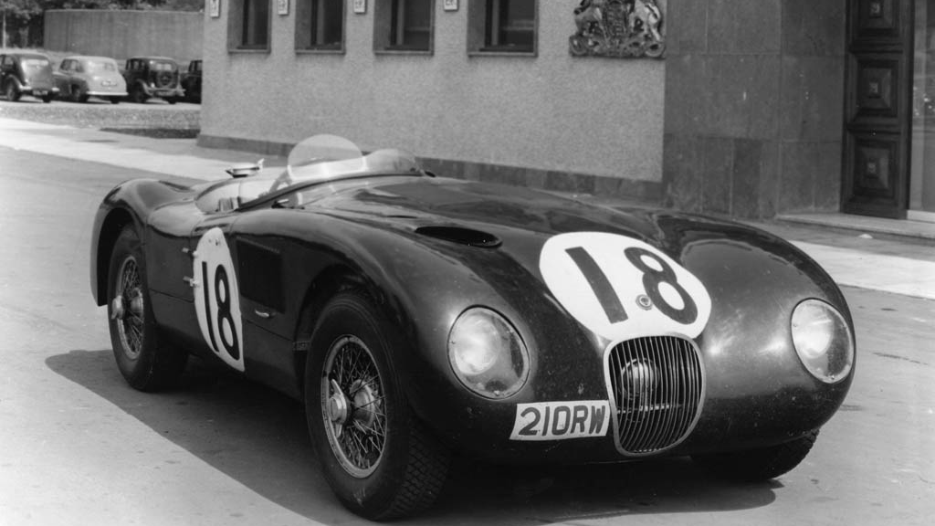
Jaguar C-Type (originally XK120-C)
Launched in 1950 , the "C" stood for "competition"
A racing sports car , it was produced from 1951 to 1953.
It was developed under Chief Engineer Bill Heynes and built in Browns Lane Experimental Dept .
The C Type used proven running gear with a lightweight tubular space frame and new torsion bar-trailing link Rear Axle .
Its aerodynamic aluminium body was specified by the famed ex-Aircraft Designer , Malcolm Sayer.
Originally tuned to around 205 bhp with the 3.4L 6-Cyl .
Early C-Types were fitted with SU carburetors and Alfin drum brakes
In 1952, Moss & Chief-Tester Dewis did not finish the 10 hour Mille Miglia, but the superiority of Disc Brakes was fully conclusive .
The 1953 C-Types were:-
Lighter & more powerful
Were fitted with four wheel Dunlop disc brakes , which proved to be a Race-winning feature .
A total of 53 C-Types were built, 43 of which sold to private owners mainly in the US.
1951 LeMans 24hrs : of 3 C-Types one finished 1st .
After an unlucky race with 3-cars overheating in 1952, C-Types were victorious in 1953 finishing 1, 2 & 3

Slide 10
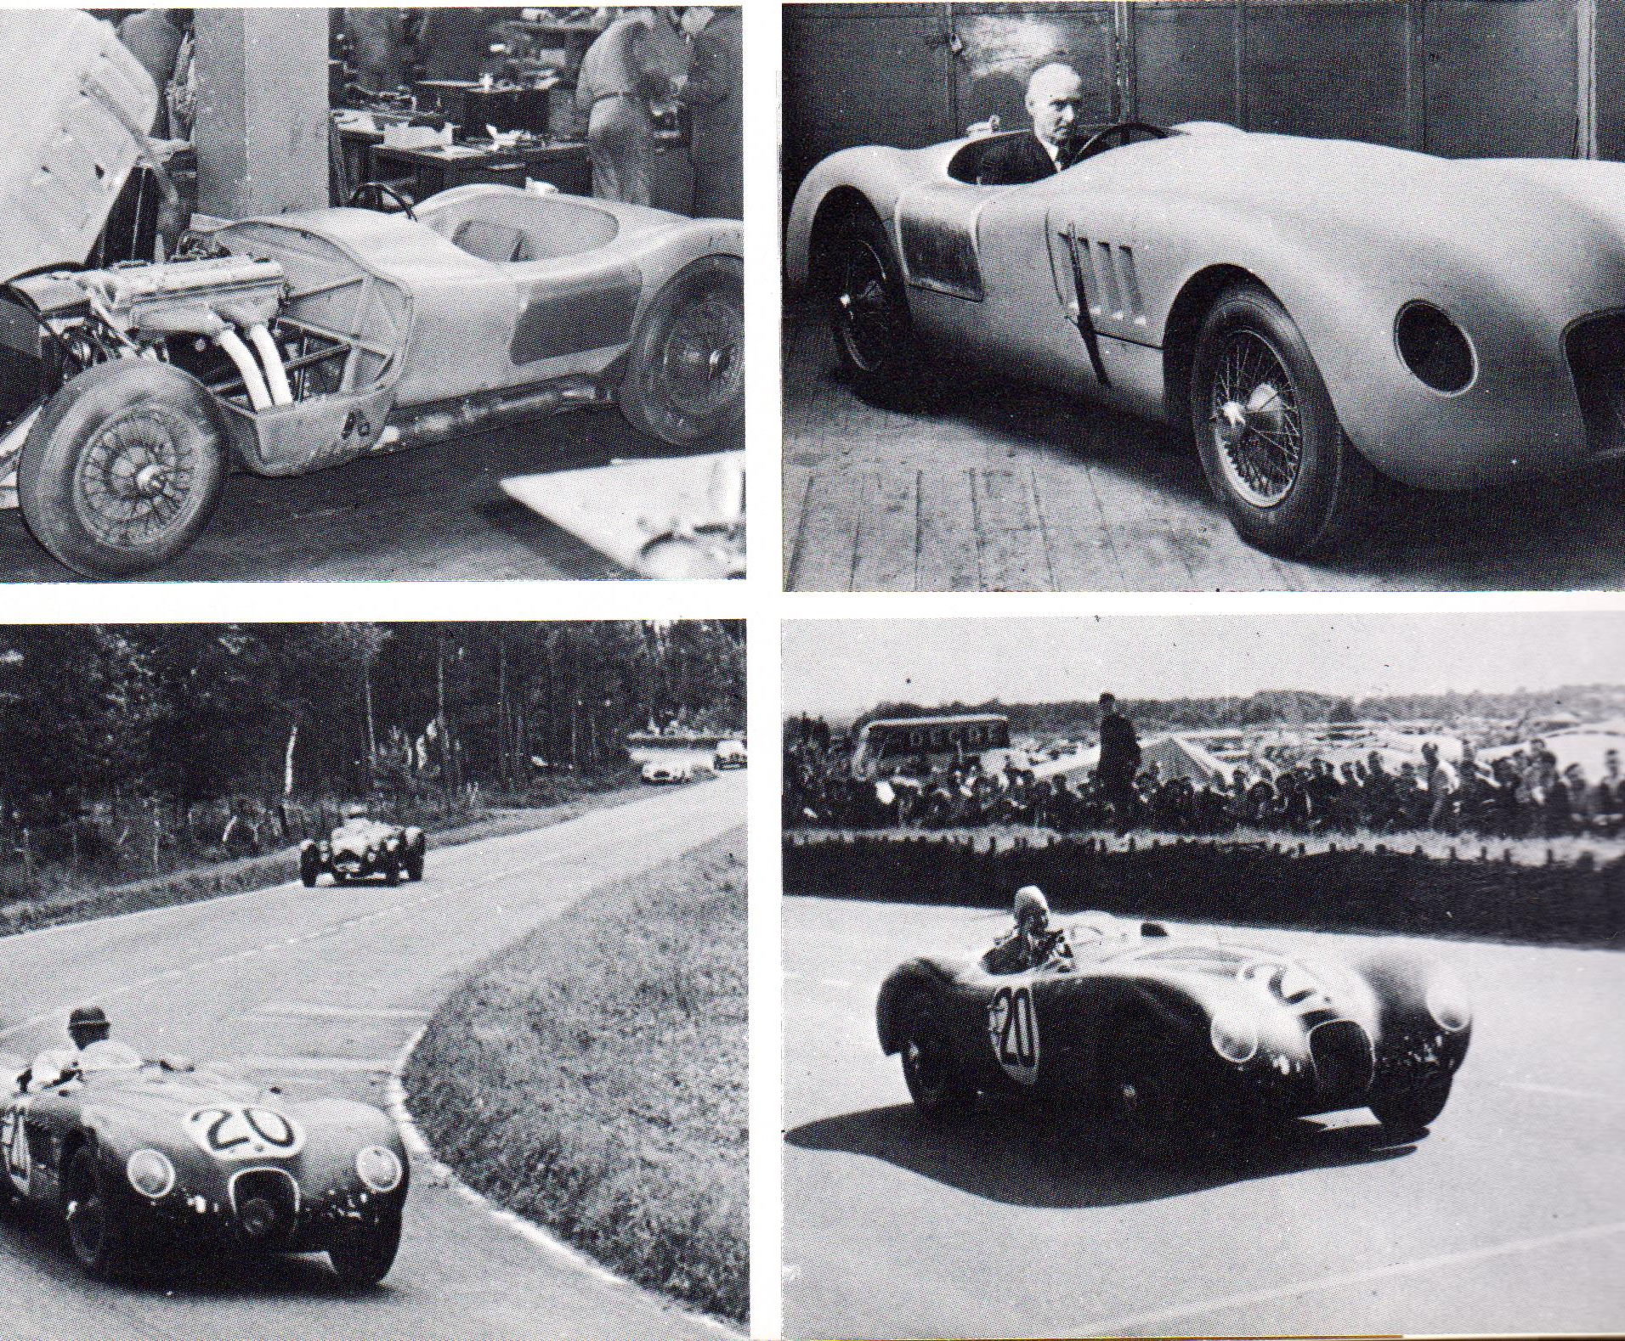
Jaguar C-Type

Slide 11
The C-D Prototype: Malcolm Sayer’s Aerodynamic Masterpiece
This one-off light-alloy hybrid went by several names, until C-D Prototype stuck
It was the first use if Malcolm Sayers "Monocoque Tub" with front Sub Frame, and would evolve into the E-Type 8 years later
First tested by Norman Dewis in May 1953 at Lindley Test track near Coventry
In Oct 1953 at the Brussels Motorway: Dewis averaged 178.4 mph (287 km/h) over 1 mile
Car had a Perspex Cockpit Bubble

Slide 12
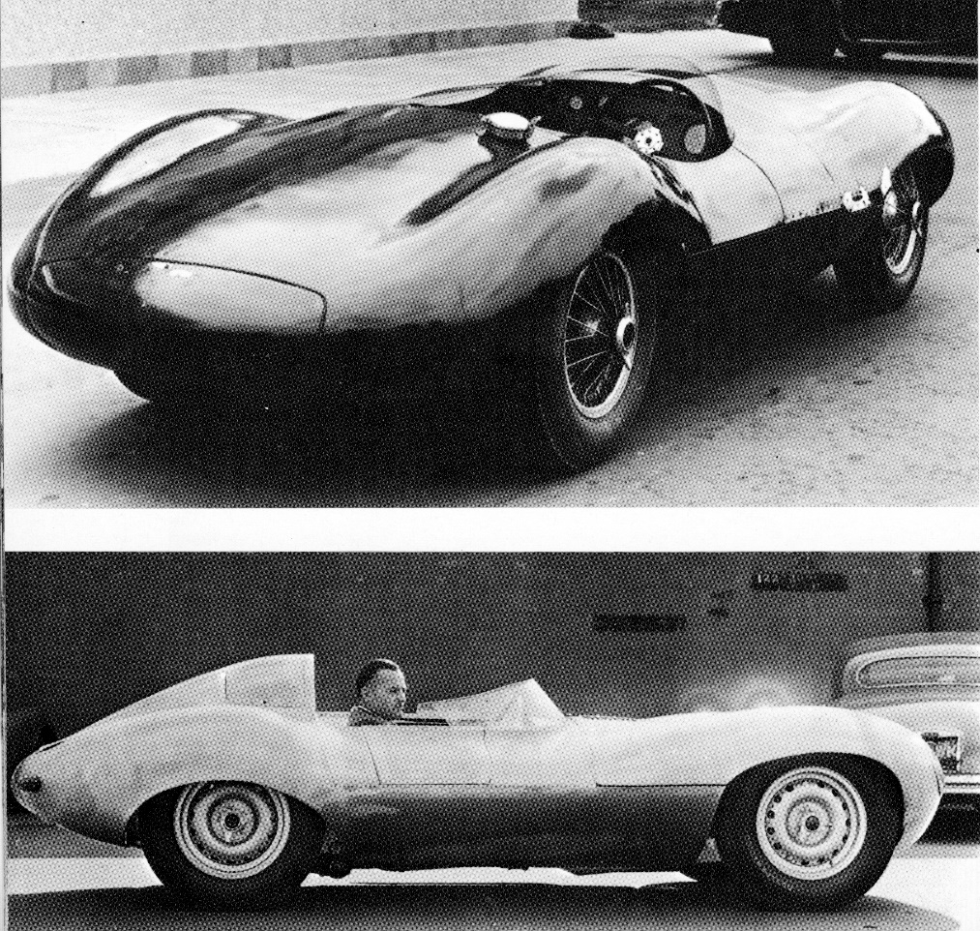
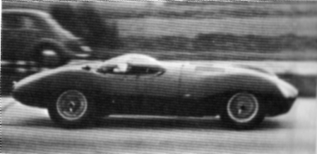
The Jaguar C-D Prototype

Slide 13
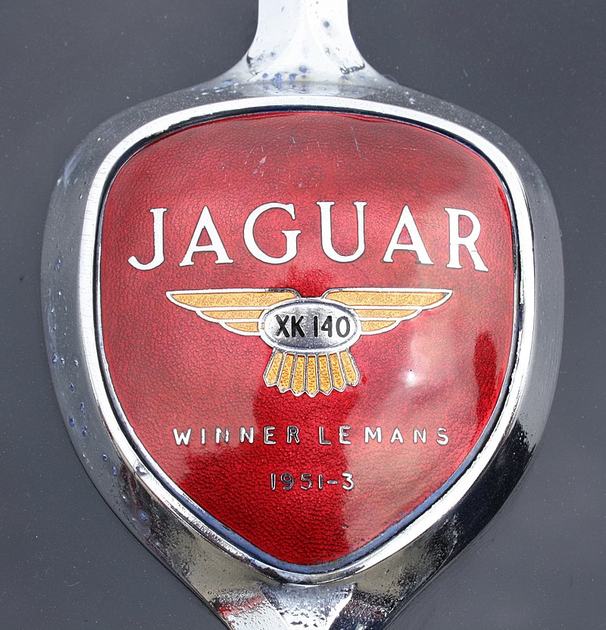
The Jaguar XK140
Manufactured between 1954 and 1957 as XK120 successor
Introduced in late 1954 and sold as a 1955 model
Upgrades from the XK120 included:
More interior space for taller drivers by moving engine, firewall and dash forward to give 3 inches more legroom
4-speed Gearbox & Overdrive & Automatic optional
Improved drum brakes
Rack and pinion steering
Increased suspension travel
Telescopic shock absorbers
Exterior changes from XK120 included more substantial front and rear bumpers with overriders and flashing turn signals

Slide 14
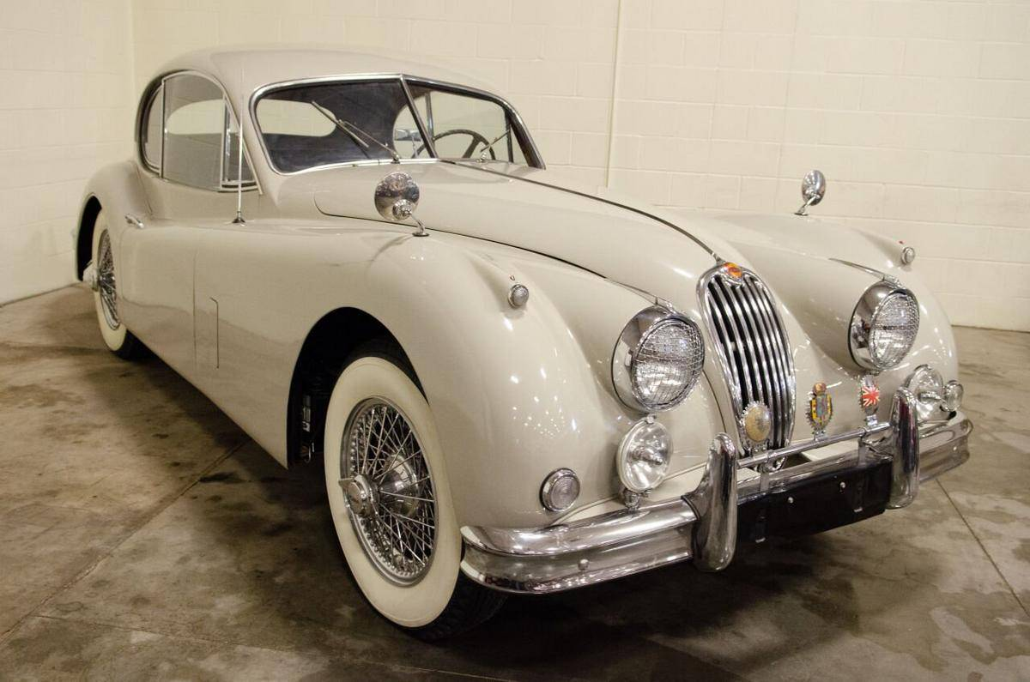
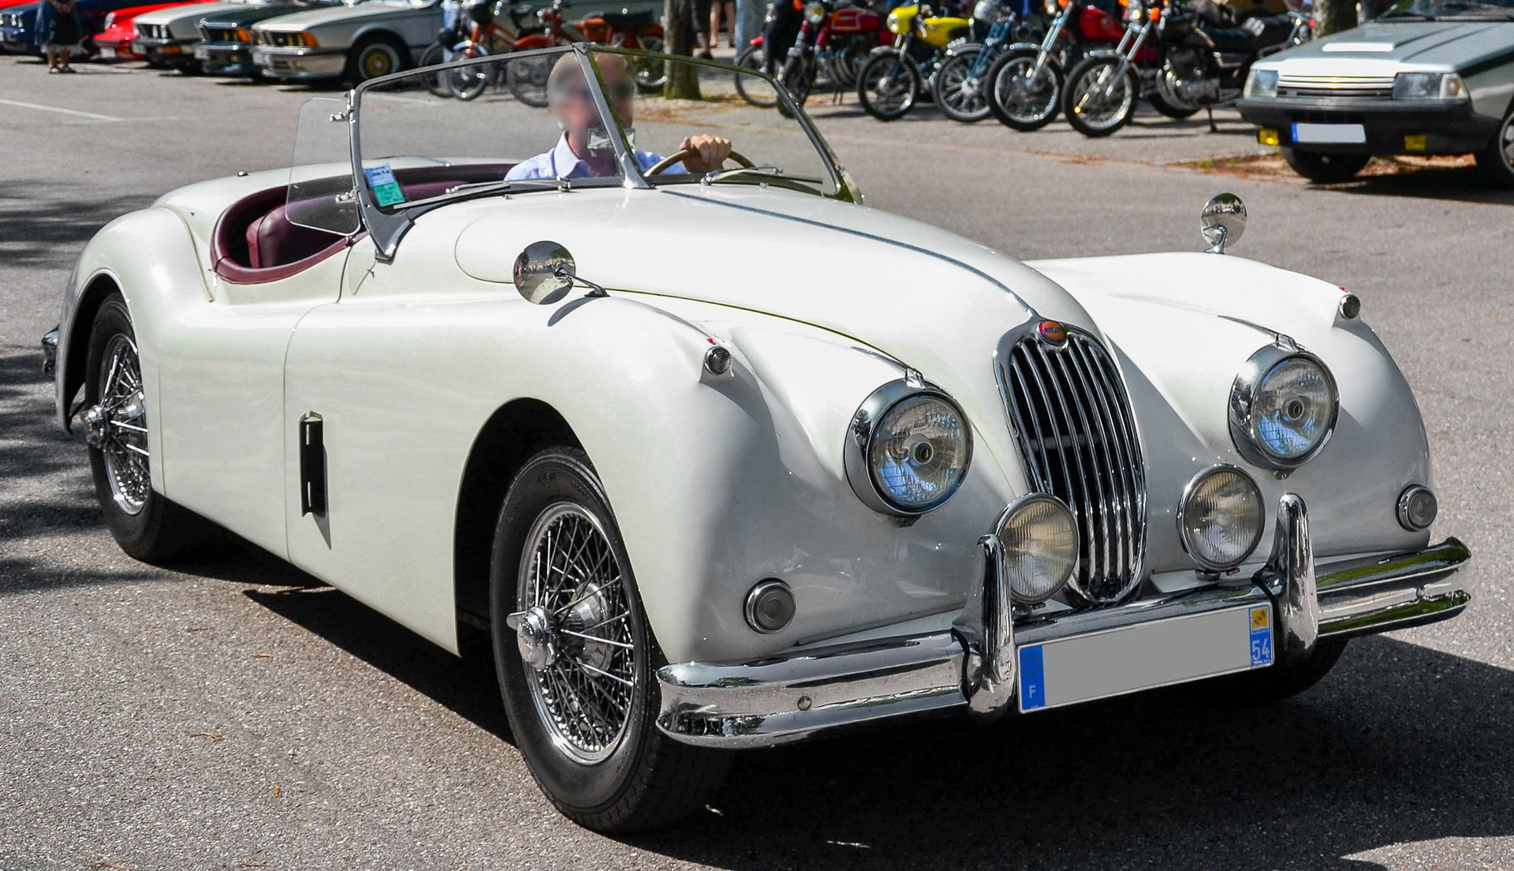
The Jaguar XK-140

Slide 15
Powering the XK140
The XK140 retained 3.4 litre double overhead camshaft straight-6 and the XK120 Special Equipment modifications, which raised power by 10 bhp to 190 bhp at 5500 rpm as standard
With optional C-Type cylinder-head from the XK120, power rose to 210 bhp at 5750 rpm
Fitted with C-type head, 2in SU- carburetors, heavier torsion bars and twin exhaust pipes, the car was designated XK140 SE in UK and XK140 MC in USA
In 1956 the XK140 was the first Jaguar sports car offered with Borg-Warner automatic transmission

Slide 16
XK140 Engines
Model | Years | Displacement | Configuration | Bore/Stroke | Carburettor | Power
XK 140 3.4 | 1954-1957 | 3442 cc | DOHC Straight-6 | 83 mm x 106 mm | Double SU H6 | 190 bhp (142 kW; 193 PS) @ 5500 rpm
XK 140 3.4 SE (C-Type Head)("MC" in USA) | 1954-1957 | 3442 cc | DOHC Straight-6 | 83 mm x 106 mm | Double SU H6 | 210 bhp (157 kW; 213 PS) @ 5750 rpm

Slide 17
Performance Tests of the XK-140
A stock XK-140 SE could achieve a top speed of 120–125 mph
Road & Track's XK-140 MC test June 1955 recorded best two-way average of 120.3 mph
Acceleration 0–60 mph between 8.4 and 9.1 secs
Only the R&T test tried 0–100 mph , which took 26.5 secs
The standing 1/4 mile took 16.6 secs and 82 mph

Slide 18
The Jaguar XK150
XK150 was produced 1957 to 1961 as XK140 successor .
PRODUCTION: 6,645 had 3,4 L & 1284 had 3.8L (1492 Automatic G-box)
Initially available as fixed head coupé (FHC) and drophead coupé (DHC)
XK 150-S Roadster launched in 1958 .
PRODUCTION: 1,911 had 3.4 L & 275 had 3,8L (all 4-speed with Overdrive) .
Minimal rear seats fitted in the coupés
Windshield semi-wrapround : first time with wind-up windows .

Slide 19
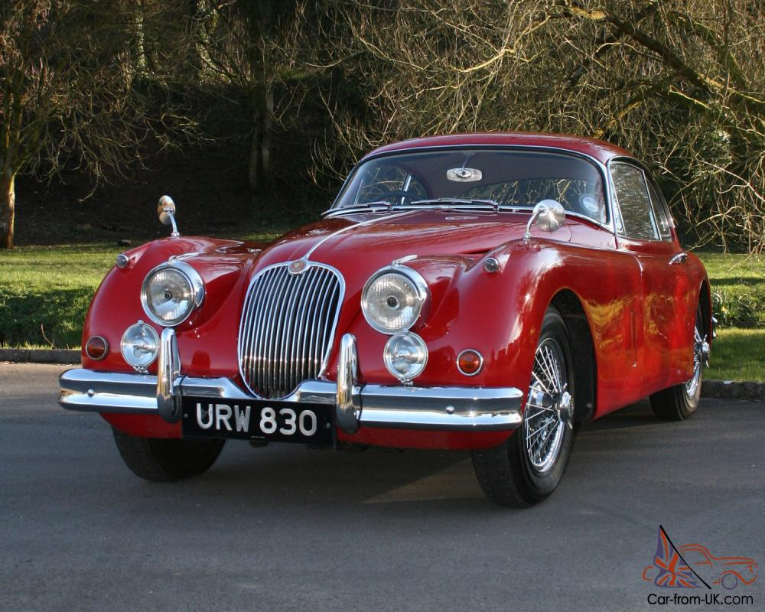
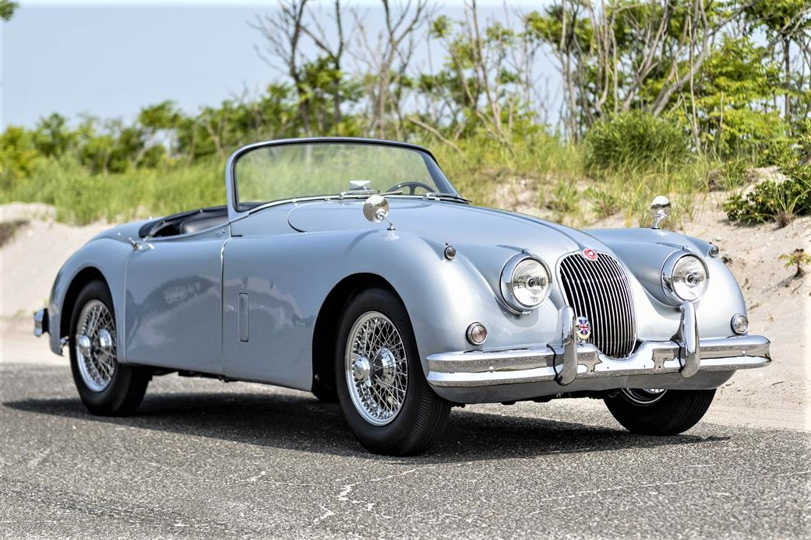
The Jaguar XK-150

Slide 20
The Jaguar XK150 Engine
Initial XK150 performance issues were corrected by Spring 1958 with introduction of Special Equipment SE engine and importantly standard 4-wheel disc brakes. The engine had:
Two 1.75-inch SU-HD6 carburettors
A B-type cylinder head with larger exhaust valves
Improved performance with 210 bhp at 5500 rpm
XK 150-S had three 2-inch SU -HD8 carburetors and a straight-port cylinder head, boosting power to 250 bhp
From 1960 the 220 bhp 3.8 L engine from the luxury Mark IX Sedan was used to produce 265 bhp in S models
Max Speed 135 mph (217 km/h) : 0–60 mph in 7.0 secs : Fuel economy 18mpg

Slide 21
XK150 Engines
XK 150 ENGINES ^{[10][11]}
Model | Years | Displacement | Configuration | Bore/Stroke | Carburettor | Power
XK 150 3.4 | 1957–1960 | 3442cc | DOHC Straight-6 | 83 mm x 106 mm | Double SU HD6 | 190 bhp (142 kW; 193 PS) @ 5500 rpm
XK 150 3.4 SE | 1957–1960 | 3442cc | DOHC Straight-6 | 83 mm x 106 mm | Double SU HD6 | 210 bhp (157 kW; 213 PS) @ 5500 rpm
XK 150 3.4 S | 1958–1960 | 3442 cc | DOHC Straight-6 | 83 mm x 106 mm | Triple SU HD8 | 250 bhp (186 kW; 253 PS) @ 5500 rpm
XK 150 3.8 SE | 1959–1960 | 3781 cc | DOHC Straight-6 | 87 mm x 106 mm | Double SU HD6 | 220 bhp (164 kW; 223 PS) @ 5500 rpm
XK 150 3.8 S | 1959–1960 | 3781 cc | DOHC Straight-6 | 87 mm x 106 mm | Triple SU HD8 | 265 bhp (198 kW; 269 PS) @ 5500 rpm

Slide 22
Performance
A 250 bhp 3.4 litre XK150S fixed-head coupé with limited-slip differential was tested by The Motor in 1959:
Top speed 132 mph
Acceleration: 0–60 mph in 7.8 secs
Fuel consumption: 18.3 mpg
Cost: £2110 including taxes of £62
At the time, it was the fastest closed car the UK magazine had ever subjected to a road test.

Slide 23
Jaguar XK150 By Bertone
In 1958 3 bare chassis were shipped to Carrosseria Bertone in Turin to receive special bodies as prototype fixed-head coupés.
They were reportedly meant to be the replacement for the XK150 and wore an "XKE" badge on their rear flanks --- a taste of things to come -----
Factory personnel were overheard wondering who "Bert One" might be!
The XK 150 would indeed be the precursor of the E-Type

Slide 24
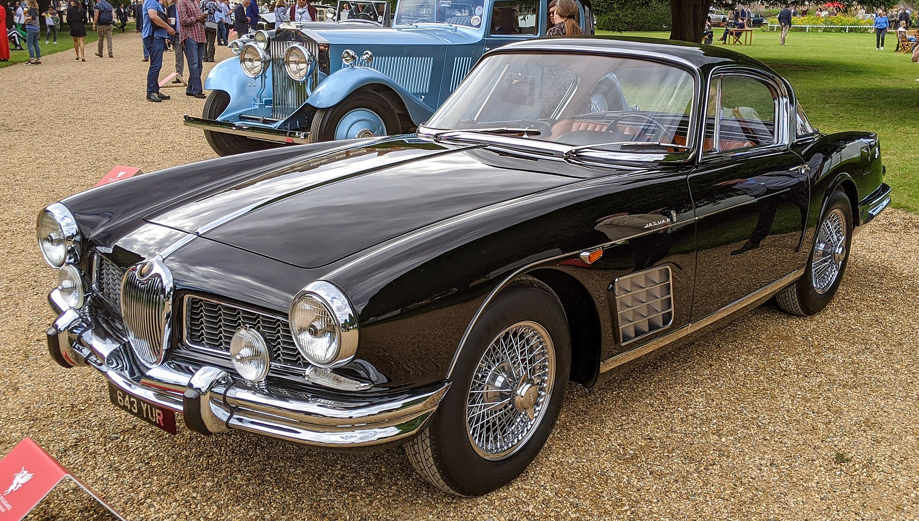
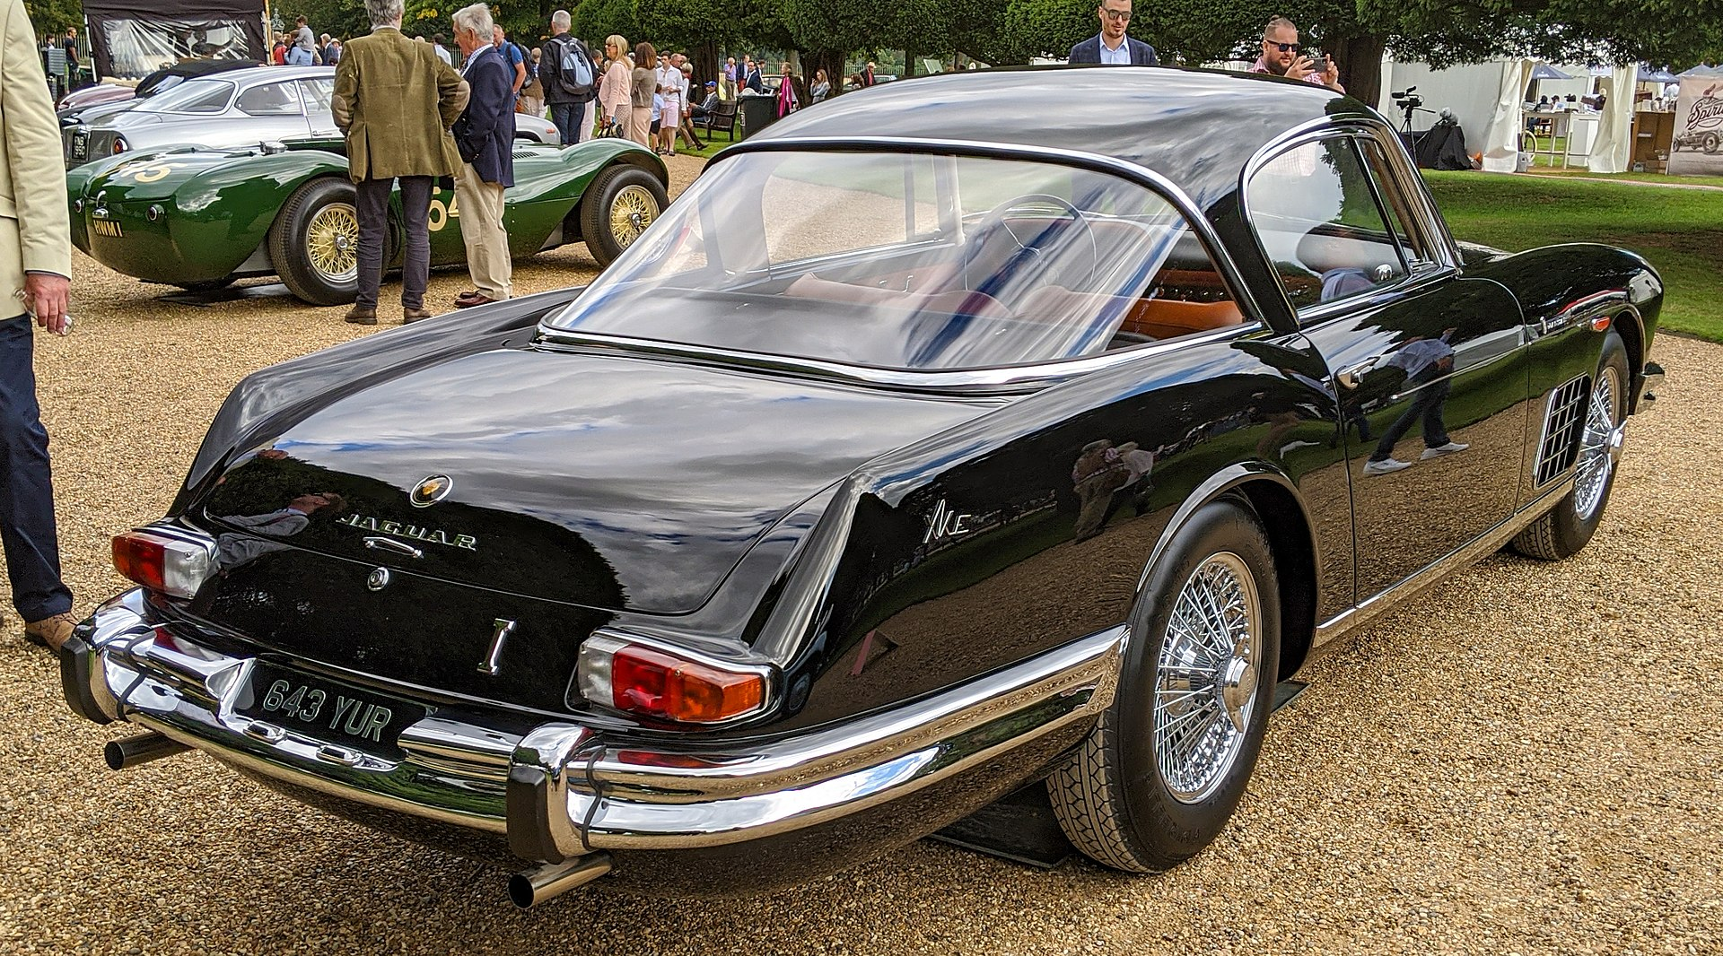
1958 Jaguar XK-150S Bertone

Slide 25
Original XKC 401 : Named D-Type June 54 at Le Mans
The Jaguar D-Type was a sports racing car produced between 1954 and 1957
Designed to win LeMans 24hr Race, it succeeded spectacularly for three consecutive years from 1955
Apr 1954, Dewis first tested the first D-Type (originally named XKC 401) Short Nose
May 1954 Le Mans Practice, Dewis drove 169 mph on Mulsanne Straight and lapped at 115 mph
It shared the straight-6 3.4 L Engine-Gearbox and some components with its C-Type predecessor
The oval cross-section body , with a one-piece tilting front structure ,reduced frontal area and was designed by Aerodynamicist Malcolm Sayer
1955 & 56 Race Rules change : Long-Nose bonnets and with full width wind-screens
Engine and Front Suspension carried by a tubular Subframe bolted to the Monocoque "Tub" at the firewall
Engine mounted lower thanks to Dry-Sump Lubrication and tilted 8 degrees
245bhp at 5750rpm
3 x Twin Choke Weber Carburetors took fuel from two flexible fuel tanks (37 gals)
SU and Lucas developed Fuel Injection options
New 4-speed Synchromesh Gera Box and Triple Plate Clutch
A distinctive vertical Tail Fin merged with the low wrap-round wind screen
A so-called passenger "seat" accessed via a removable panel: With twin side-exhausts below a true Hot Seat
Weighed only 2900 pounds

Slide 26
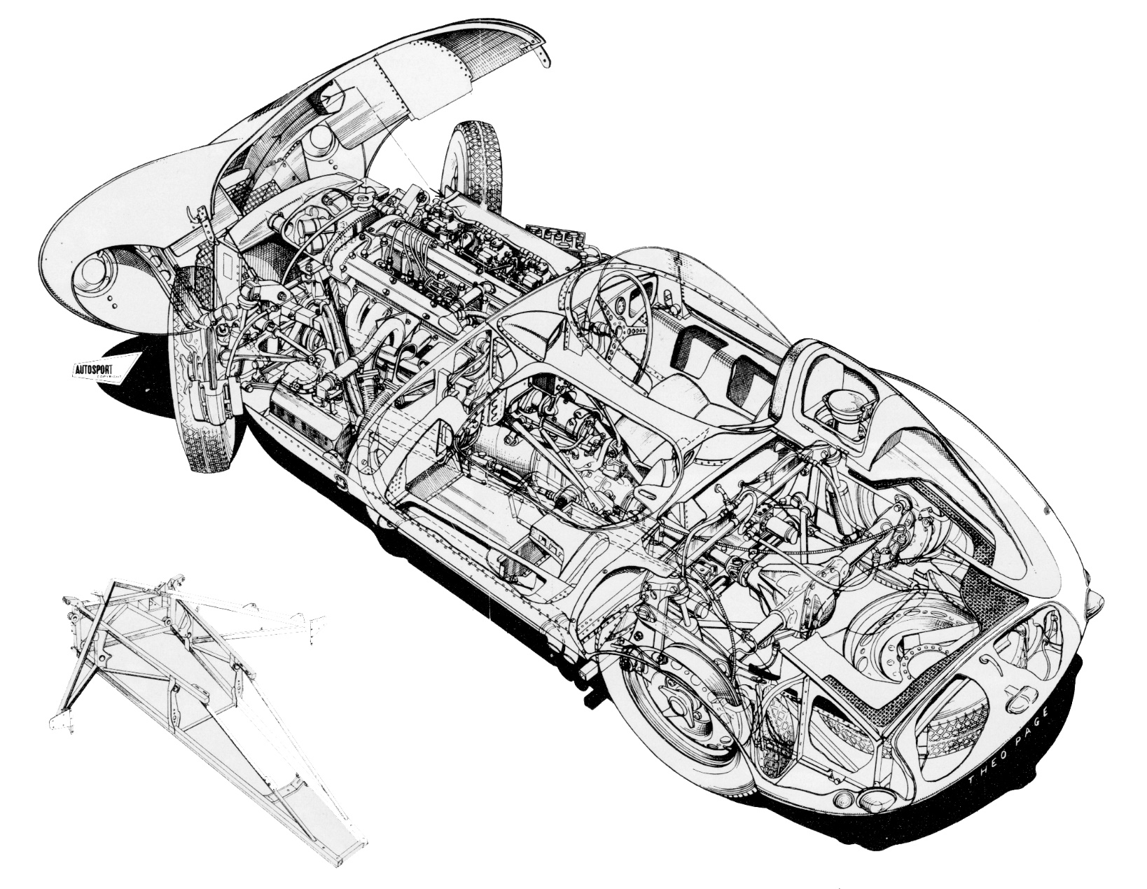
Sectional Drawing D-Type

Slide 27
The Jaguar D-Type

Slide 28
D-Type Racing Successes
D-Type Production : 71 built (plus 16 XK-SS )
1954 Le Mans 24hrs: 3 ran, 1 finished 2nd : 105 secs behind Ferrari !
Fastest at 172 .8 mph on Mulsanne Straight
1954 Rheims 12 hrs : 3 ran , 2 finished 1st & 2nd
1955 Le Mans 24 hrs : 3 ran + 2 Private cars : 2 finished 1st & 3rd. Victory marred by 80 deaths in multi-car accident
1956 Le Mans 24hrs: 3 Factory & 3 Private cars : 2 finished 1st & 4th
End 1956 Factory Race Team disbanded : 2 cars sold to Ecurie Ecosse
Jan 1957 D-Type-based XK - SS production start
Feb 12-1957 Factory Fire : production resumed in 2 days!
1957 Le Mans 24 hrs : Four Teams ran 5 cars : Five finished 1-2-3-4-6

Slide 29
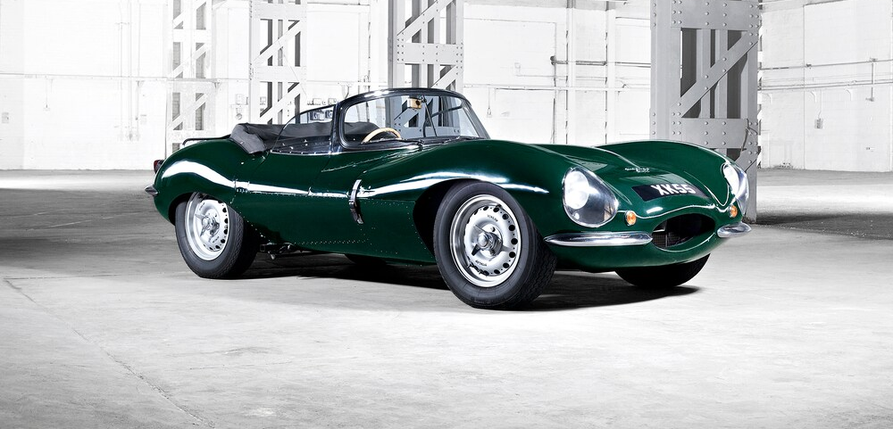
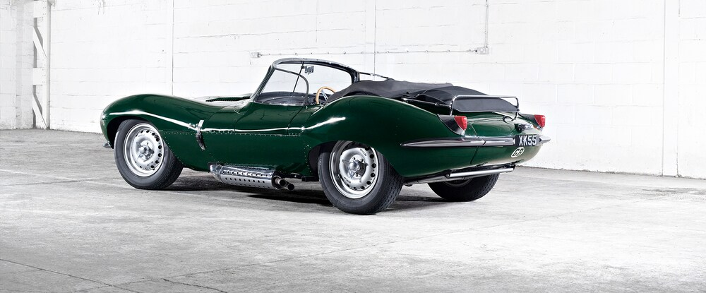
1957 Jaguar XK SS: 16 Survived Fire

Slide 30
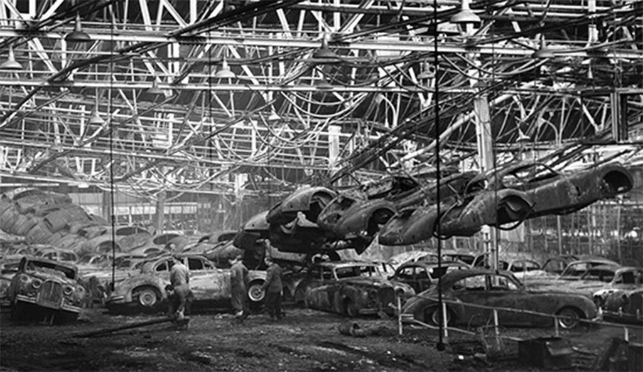
Feb 12 , 1957 Jaguar Factory Fire

Slide 31
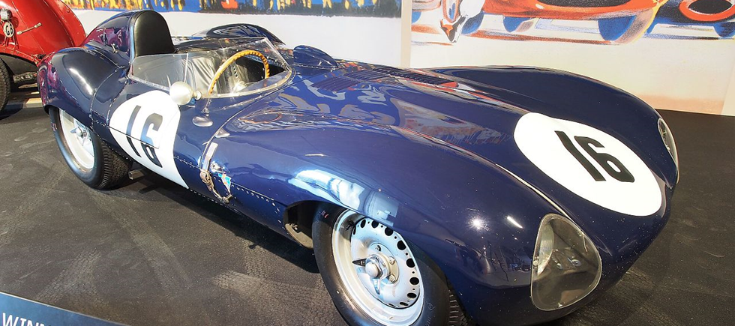
The Jaguar XK-D Type

Slide 32
Evolution D-Type to E-Type
1957 : Body E1A : D-Type-based prototype, first with 2.4L 4-Cyl and Independent Rear Suspension (IRS)
After testing, decision to keep 3.4 & 3.8L Engines (Car scrapped end 59)
1958 LeMans Rules change to max 3.0L
1959-60: Body E2A with 3L engine : performance issues cured by reverting to 3.8 L engine: US Importer Cunningham ran car at Le Mans
1961: Car "rescued'' by Woodley & Griffiths Families in their Museum
2008: Sold to Swiss owner, who ran it at 50th Anniv. Le Mans in 2010

Slide 33
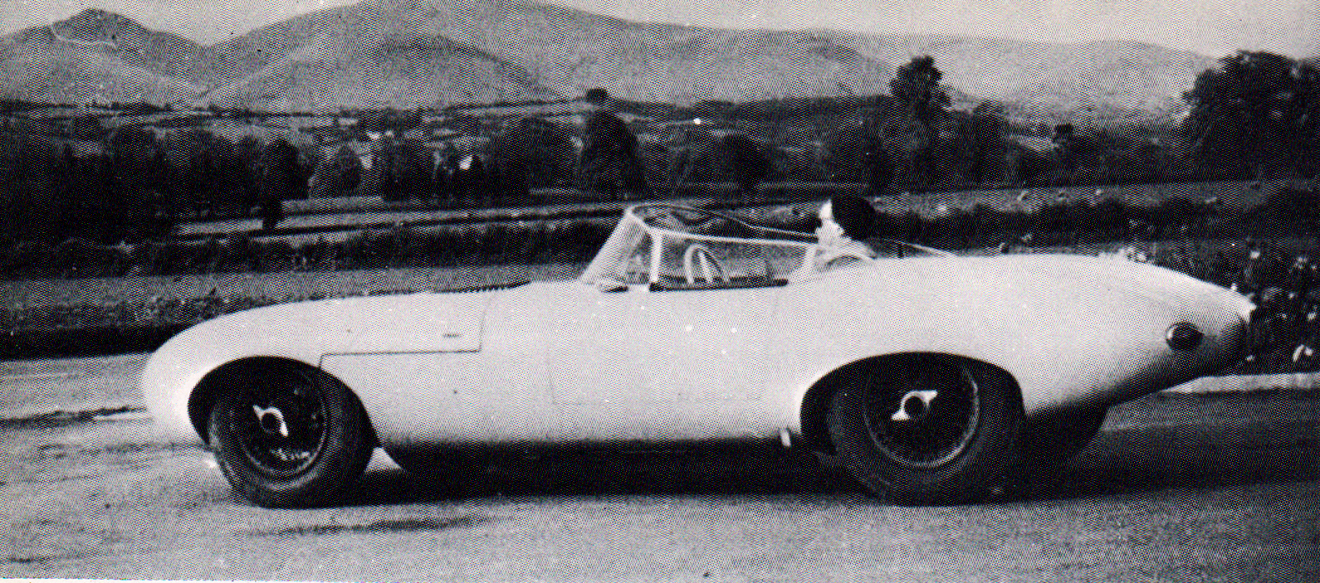
1957 E1A Prototype

Slide 34
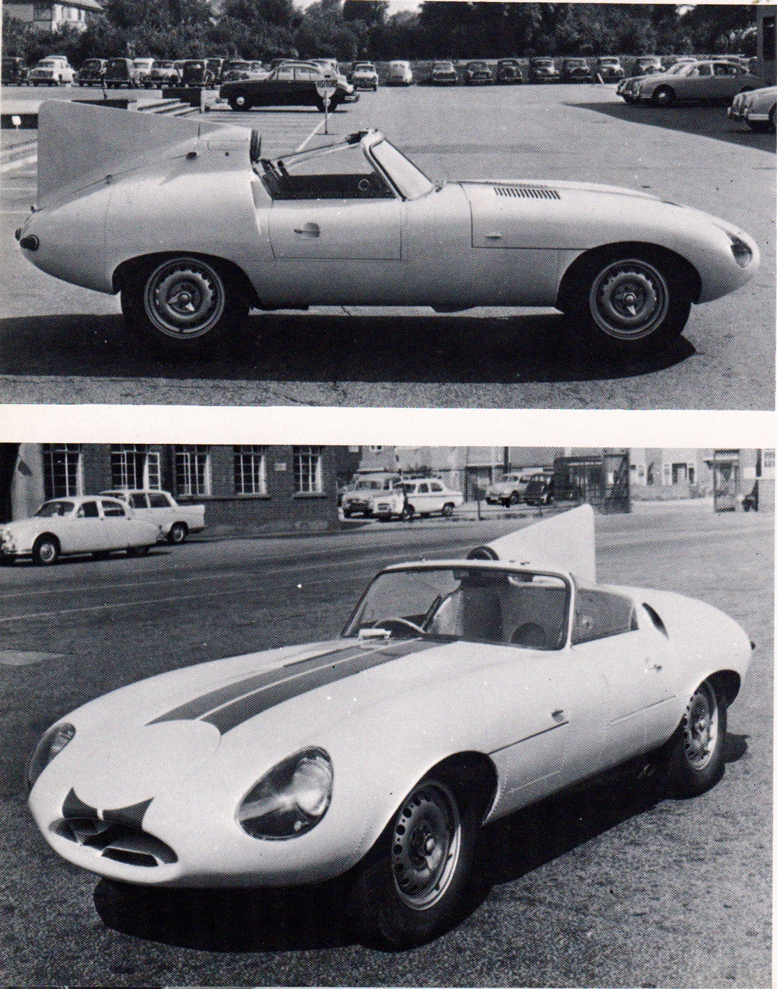
Cunningham's 1959 E2A Prototype

Slide 35
The Iconic Jaguar E -Type
Festive launch March 1961 at the Geneva Show
1961-64, built 15,490 3.8L
1965-68, built 17,320 4.2L
1966 2+2 Coupe launched at Geneva Show : 5,600 built
1968, Series 2: 13,490 built w 4,2L
1969-70, Series 2: 5,330 2+2 built w 4.2L
1971-75, Series 3: 7,300 built w 5.3L V12
Ultimately, 72,520 E-Types Series would be built between 1961 and 1975
Its combination of striking beauty, performance and pricing established the model as an permanent icon of the motoring world with 150 mph top speed and sub-7-sec 0 to 60 mph acceleration.
Its monocoque + subframe construction, disc brakes, and independent rear suspension distinguished the car and spurred industry-wide changes

Slide 36
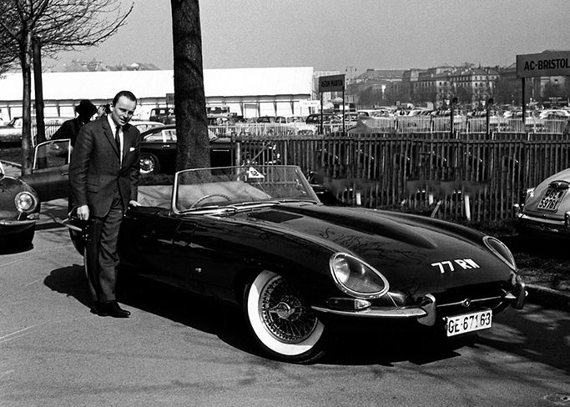
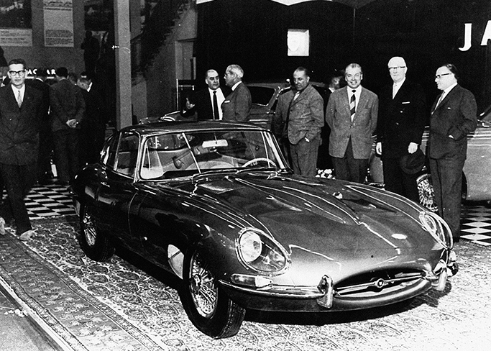
Jaguar E Introduction at 1961 Geneva Show

Slide 37
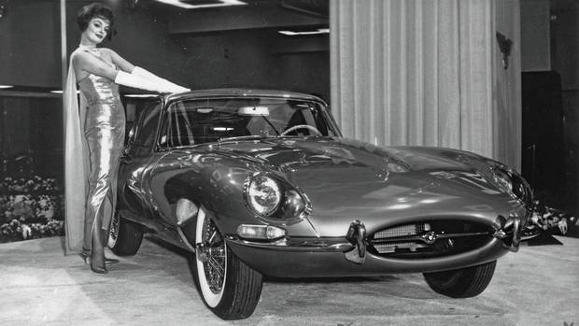
In 1961 the Jaguar E-Type made its North American debut at the New York International Auto Show
Attracted record-breaking crowds, with 47,000 people squeezing on to the Jaguar stand on Day One alone, completely stealing the show!
A gold E-Type coupe was joined on the turntable by Playboy model, Marilyn Hanold, dressed in a shimmering gown, white gloves and floor-length silk scarf

Slide 38
Evolution of the E-Type Jaguar
The E-Type was introduced in 1961 as:
Grand tourer coupé and a two-seater convertible "roadster"
A "2+2" four-seat version of the coupé, with longer wheelbase, was released in 1966
Model updates were designated "Series 2" and "Series 3" : over time, the earlier cars are now referred to as "Series 1
Series 1 cars fell into two categories:
Those between 1961-1964 had 3.8 L engines
Those between 1965-1967 increased engine torque & size by 10% to 4.2 L

Slide 39
Summary
Among the great classic automobiles, the E-Type remains a collectors' & enthusiasts' favourite
Jaguar founder Willam Lyons's eye-for-style was evident from the outset in the 1920's : a series of performance cars in 1930's set the stage for the post-WW2 arrival of the XK120 (1949-54)
Spectacular 1949 London & NewYork unveilings, led to the evolution of the XK140 (1954-57), XK 150 (1957-60) and XK150-S (1958-60)
In 1950, Jaguar decided to use racing to promote sales: first at Le Mans in 1951, the C-Type won many classic events .
From late-53 to mid-54, the "C-D Prototype" was the precursor to D- & E-Type development achieving 178 mph in Oct 53.
After D-Types won LeMans24 hrs in 1955, 56 & 57, private teams took over racing, with factory support.
In 1957, the D-Type-based "E1A Prototype" featured E-Type's main design elements, whilst work on production Coupe & Roadster proceeded.
With great fanfare, Sir William presented the E-Type at the March 1961 Geneva Show, its stunning looks & 150mph top speed being top features.
In 1959-60 an "E2A Prototype", loaned to US Importer Cunningham, ran in the Le Mans 50th Anniversary Race in 2010 .

Slide 41
E-Type Series 1 Road Tests
Motor Magazine: "The new 4.2 supersedes the early 3.8 as the fastest car Motor has tested. The absurd ease which 100 mph (161 km/h) can be exceeded in a ¹⁄₄ mile (402 m) never failed to astonish. 3,000 miles of testing confirms that this is still one of the worlds outstanding cars"
Autocar: it as "In its 4.2 guise the E-Type is a fast car (the fastest we have ever tested) and offers just about the easiest way to travel quickly by road."

Slide 42
XK-E Initial Engines
The 4.2-litre engine produced the same power as the 3.8-litre (265 bhp;198 kW) and same top speed (150 mph;241 km/h)
Torque was increased approximately 10% from 240 to 283 lb⋅ft
Acceleration remained pretty much the same and 0 to 60 mph times were around 6.4 seconds
Maximum power was now reached at 5,400 rpm instead of 5,500 rpm on the 3.8-litre
That all meant better throttle response for drivers that did not want to shift down gears
The 4.2-litre's block was completely redesigned, made longer to accommodate 5 mm (0.20 in) larger bores, and the crankshaft modified to use newer bearings.
Other engine upgrades included a new alternator/generator and an electric cooling fan for the radiator

Slide 43
Jaguar XK-E Series 2 Changes
The most distinctive exterior feature was the absence of the glass headlight covers
Series 2 cars had a wrap-around rear bumper, larger front indicators and tail lights re-positioned below the bumpers, and an enlarged grille and twin electric fans to aid cooling
They also had:
A steering lock which moved the ignition switch to the steering column, replacing the dashboard mounted ignition and push button starter
The symmetrical array of metal toggle switches were replaced with plastic rockers
A collapsible steering column to absorb impact in the event of an accident
New seats allowed the fitment of head restraints, as required by U.S. law beginning in 1969
The engine is easily identified visually by the change from smooth polished cam covers to a more industrial "ribbed" appearance
The engine was de-tuned in the US with twin two-barrel Strombergs replacing three SUs. Reducing horsepower from 265 to 246 and torque from 283 to 263
Air conditioning and power steering were available as factory options

Slide 44
Jaguar XK-E Series 2 Series 2 (1968–71)
Overview
Also called | Jaguar XK-E^{[50]}
Production | 1968–71^{[31][32]}
Body and chassis
Body style | 2-door fastback coupé 2-door 2+2 fastback coupé 2-door roadster
Powertrain
Engine | 4.2 L XK I6
Dimensions
Kerb weight | 3,018 lb (1,369 kg) (FHC) 2,750 lb (1,247 kg) (OTS) 3,090 lb (1,402 kg) (2+2)^{[34]}

Slide 45
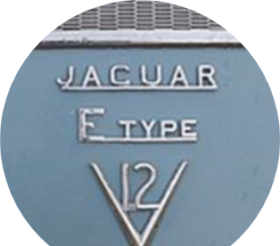
Jaguar XK-E Series 3 Changes
The E-Type Series 3 was introduced in 1971
It had a new 5.3 L Jaguar V12 engine, uprated brakes and standard power steering.
The V12 was equipped with four Zenith carburetors
It produced a claimed 203 kW (272 hp), more torque, and a 0-60 mph acceleration of less than seven seconds
The short wheelbase FHC body style was discontinued, with the Series 3 available only as a convertible and 2+2 coupé.
The final production E-Type OTS Roadster was built in June 1974]
Optionally an automatic transmission, wire wheels and air conditioning were available.
The Series 3 is easily identifiable by the large cross-slatted front grille, flared wheel arches, wider tires, four exhaust tips and a badge on the rear that proclaims it to be a V12

Slide 46
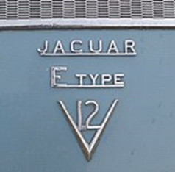
Jaguar XK-E Series 3 Changes, ct’d.
The newly used longer wheelbase offered significantly more room in all directions
Easily identifiable by the large cross-slatted front grille, flared wheel arches, wider tires, four exhaust tips and a badge on the rear that proclaims it to be a V12
The first published road test of the series 3 was in Jaguar Driver, the club magazine of the Jaguar Drivers' Club
Cars for the US market were fitted with large projecting rubber bumper over-riders (in 1973 these were on front, in 1974 both front and rear) to meet local 5 mph impact regulations,
US models also had side indicator repeats on the front wings.
There was a very limited number of six-cylinder Series 3 E-Types built.
The V12 Open Two Seater and V12 2+2 were factory fitted with Dunlop E70VR − 15-inch tires on 15 × 6K wire or solid wheels

Slide 47
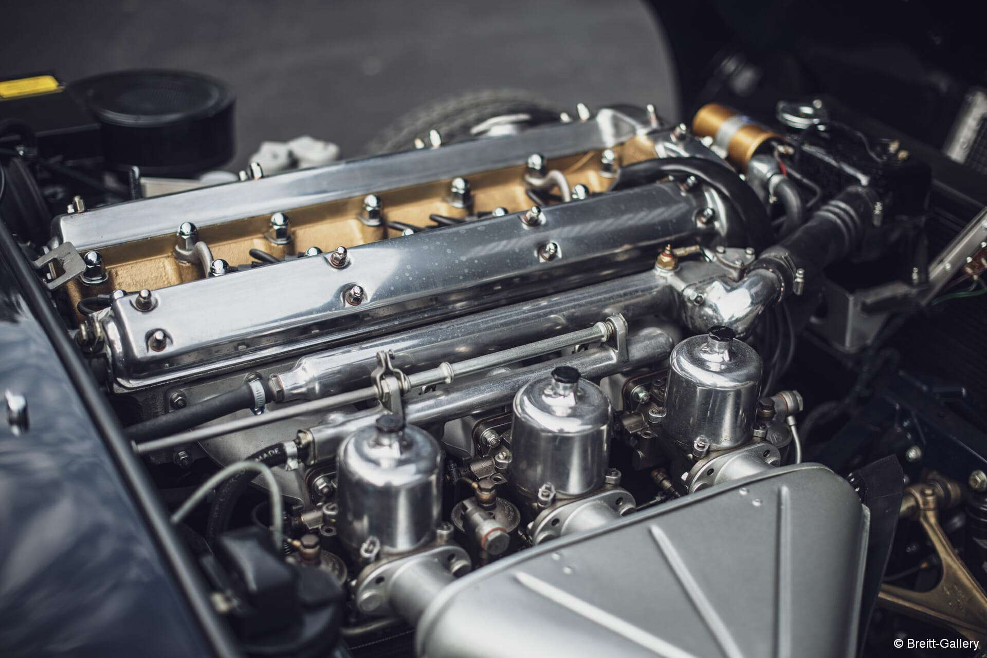
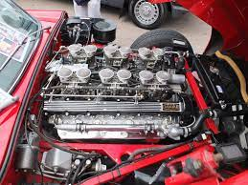
Jaguar XK-E Engines
V8
V12

Slide 48
Motorsports
The 1963 Australian GT Championship was won by a "lightweight" E-Type
The Jaguar E-Type was very successful in SCCA Production sports car racing with Group 44 taking the B-Production championship with a Series-3 V12 racer in 1975
A few years later aGran-Turismo Jaguar from Cleveland Ohio campaigned a 4.2-litre six-cylinder FHC racer in SCCA production series, and in 1980 won the National Championship in the SCCA C-Production Class, defeating a fully funded factory Nissan Z-car team with Paul Newman

Slide 49
Summary
See slide 39

